Slide 1
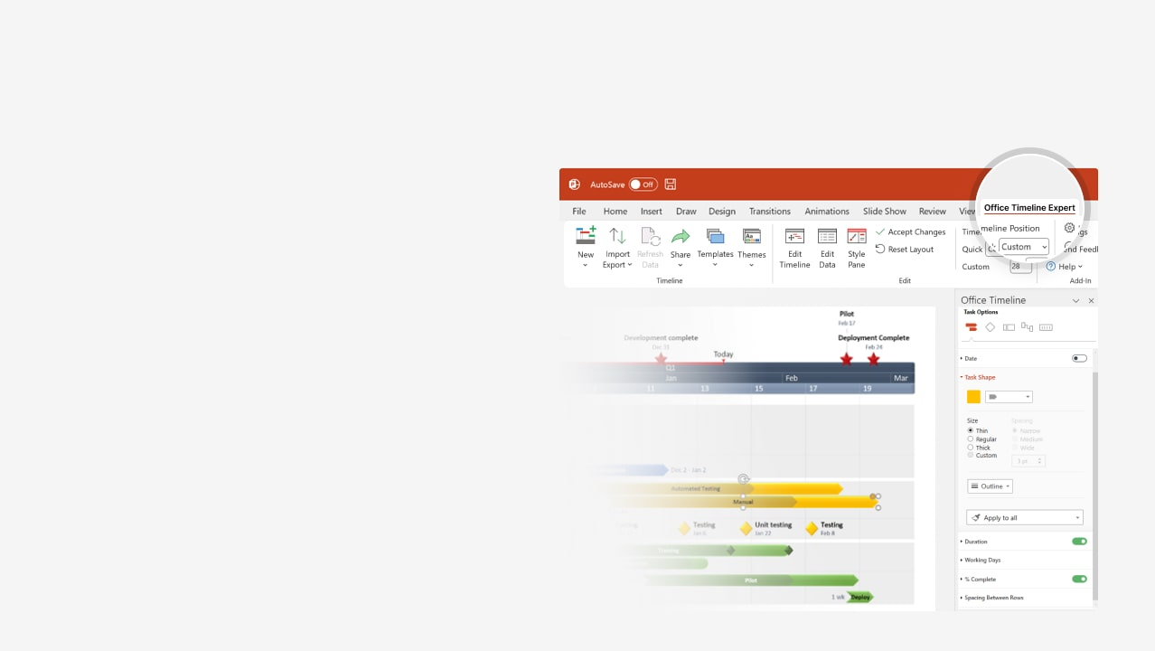

How to update this template in seconds
The Office Timeline add-in for PowerPoint will help you edit it with just a few clicks.
Get your free 14-day trial of Office Timeline here: https://www.officetimeline.com/office-timeline/14-days-trial Re-open this template, and create your impressive PowerPoint visual in 3 easy steps:
1
Click the Edit Data button on the Office Timeline tab.
2
Use the Data and Timeline views to edit swimlanes, milestones and tasks.
3
Click Save to instantly update the template.

Slide 2
100%
100%
80%
60%
PowerPoint Gantt chart
Project Kickoff
Executive Review
Go No-go Decision
Beta Release
Final Release
Project Close
Jan 10
Mar 7
Apr 29
Jun 29
Oct 20
Nov 30
2025
Jan
Feb
Mar
Apr
May
Jun
Jul
Aug
Sep
Oct
Nov
2025
Today
Requirements
35 days
Jan 13 - Mar 1
Prototype
30 days
Feb 2 - Mar 14
Specs
36 days
Mar 14 - May 2
Development
84 days
Mar 25 - Jul 18
Stabilize
18 days
Aug 16 - Sep 10
Launch
25 days
Sep 28 - Nov 1

