Slide 1
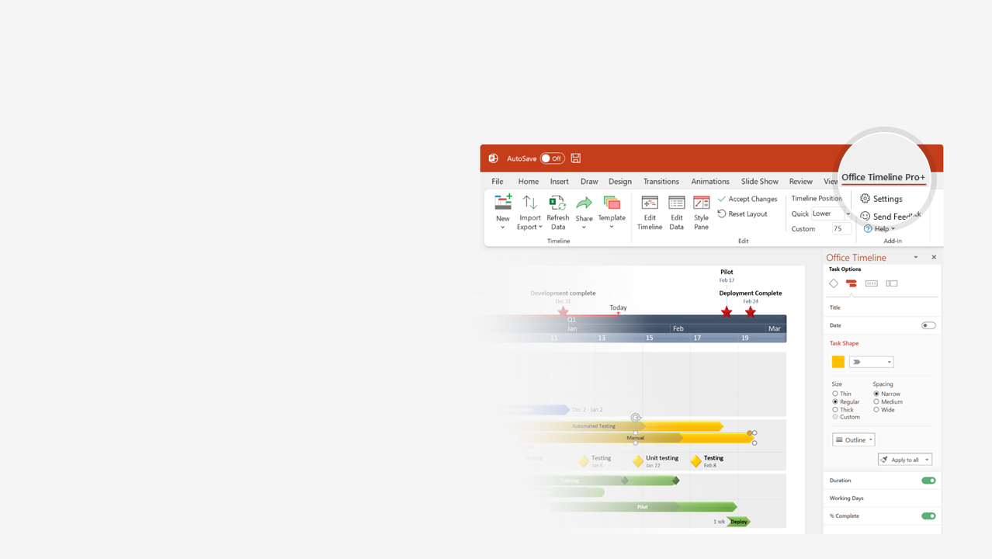

How to update this template in seconds
The Office Timeline add-in for PowerPoint will help you edit it with just a few clicks.
Get your free 14-day trial of Office Timeline here:
https://www.officetimeline.com/office-timeline/14-days-trial
Re-open this template, and create your impressive
PowerPoint visual in 3 easy steps:
1
Click the Edit Data button on the Office Timeline tab.
2
Use the Data and Timeline views to edit swimlanes, milestones and tasks.
3
Click Save to instantly update the template.

Slide 2
Sep 1 - Sep 29
6.2 days
Aug 1 - Sep 29
Aug 1 - Aug 11
Sep 19 - Sep 29
8.2 days
6.2 days
Jul 1 - Jul 29
Jun 1 - Jul 29
Jul 10 - Jul 20
Jul 20 - Jul 29
Sep 10 - Sep 20
Aug 10 - Aug 21
Aug 20 - Aug 30
Jun 19 - Jun 29
8 days
Aug 1 - Aug 30
Sep 1 - Sep 11
Jun 10 - Jun 20
Jun 1 - Jun 10
Jun 1 - Jun 29
Jul 1 - Jul 11
7.5 days
8 days
7.9 days
6.9 days
6.6 days
8 days
7 days
7 days
Today
Agile Project Plan
Staging R1
Staging R2
2021
Jul 23
Sep 20
2021
Kick-Off
Release 1
Release 2
Jun 1
Jul 29
Sep 29
Jun
Jul
Aug
Sep
Jun 30
Jul 15
Jul 20
Jul 25
Jul 29
Aug 31
Sep 29
Stakeholder Review
Strategy Meeting
Stakeholder Review
Strategy Meeting
T1
Review Agile Project Plan
Review Agile Project Plan
Jun 29
T2
Jul 29
21 days
21 days
Release 1
Sprint 1
Sprint 2
T3
Work Item 1
Work Item 2
Work Item 3
Work Item 1
Work Item 2
Work Item 3
Sep 15
Sep 20
Sep 25
QA + Refinement
43 days
Review Agile Project Plan
Review Agile Project Plan
Aug 30
Sep 29
21 days
21 days
Release 2
Sprint 3
Sprint 4
Work Item 1
Work Item 2
Work Item 3
Work Item 1
T1
Work Item 2
Work Item 3
43 days
QA + Refinement
T2
S3

