Slide 1
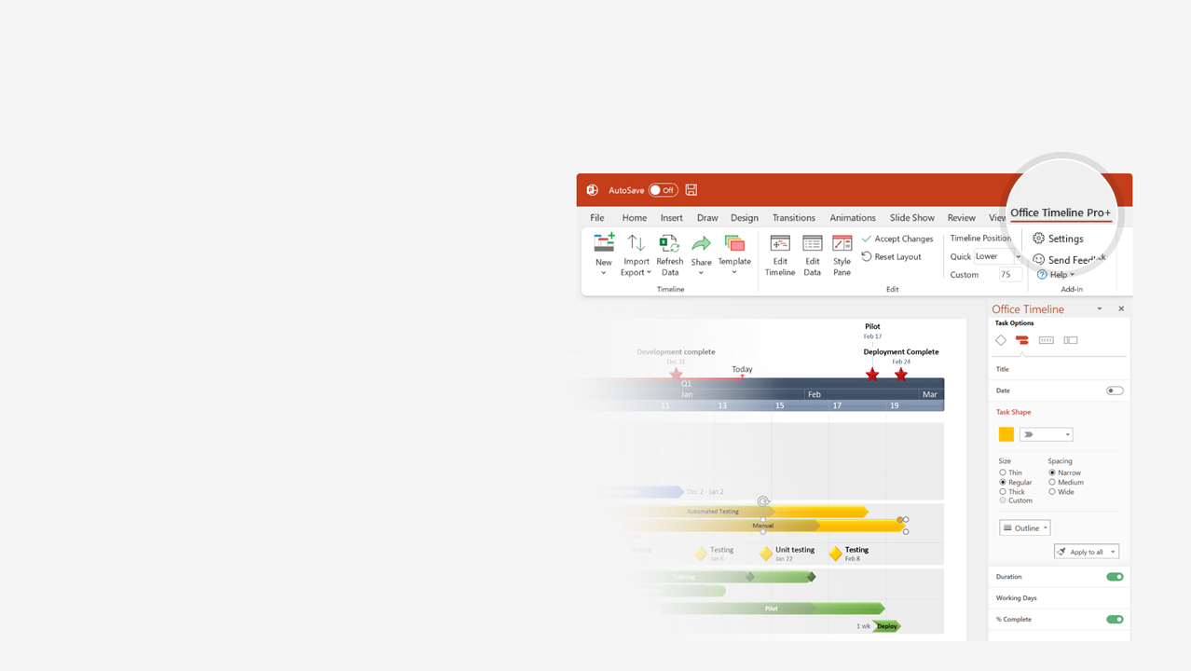

How to update this template in seconds
The Office Timeline add-in for PowerPoint will help you edit it with just a few clicks.
Get your free 14-day trial of Office Timeline here: https://www.officetimeline.com/office-timeline/14-days-trial Re-open this template, and create your impressive PowerPoint visual in 3 easy steps:
1
Click the Edit Data button on the Office Timeline tab.
2
Use the Data and Timeline views to edit swimlanes, milestones and tasks.
3
Click Save to instantly update the template.

Slide 2
Agile Task Management
9/3 - 9/17
Phase 1
10 days
9/3 - 9/4
Generate Analytics
1 day
9/5 - 9/9
Security Improvements
4 days
9/10 - 9/16
Review Storage Solutions
5 days
9/17
Migrate CMS
0 days
Task Planning Meeting
Review Backlog
Client Review
Task Management Review
Release
Aug 29
Sep 4
Sep 10
Sep 18
Oct 3
2017
Day 1
4
7
10
13
16
19
22
25
28
31
34
2017
9/18 - 10/3
Today
Phase 2
12 days
9/18 - 9/23
Performance Enhancements
5 days
9/24 - 9/26
Resource Optimization
2 days
9/27 - 10/3
Website Responsiveness
5 days
9/27 - 10/2
Automate Testing
4 days

