Slide 1
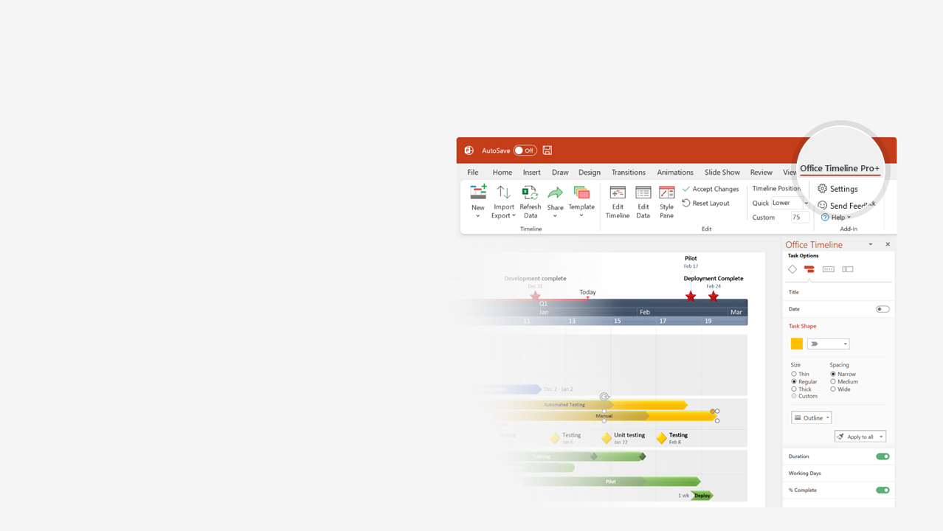

How to update this template in seconds
The Office Timeline add-in for PowerPoint will help you edit it with just a few clicks.
Get your free 14-day trial of Office Timeline here: https://www.officetimeline.com/office-timeline/14-days-trial Re-open this template, and create your impressive PowerPoint visual in 3 easy steps:
1
Click the Edit Data button on the Office Timeline tab.
2
Use the Data and Timeline views to edit swimlanes, milestones and tasks.
3
Click Save to instantly update the template.

Slide 2
0.3 days
0.3 days
0.2 days
0.3 days
0.3 days
0.3 days
0.3 days
0.3 days
0.3 days
0.2 days
0.3 days
0.3 days
0.2 days
Sep 12
Sep 12
Sep 13
Sep 14
2022
2022
Today
PowerPoint swimlane diagram auto-generated with Office Timeline
Order placed
[Notification]
[Notification]
Order received
Mon
Tue
Wed
Customer
Submit
order form
Receive
goods
Customer Service
Form
complete?
No
Notify
customer
[resubmit]
Notify
customer
[check order]
Yes
Sales
Receive order
Cancel order
Warehouse / Shipping
No
Check stock
In stock?
Yes
Ship order
No
Invoicing / Payment
Check
payment
method
Payment
valid?
Yes
Issue invoice

