Slide 1
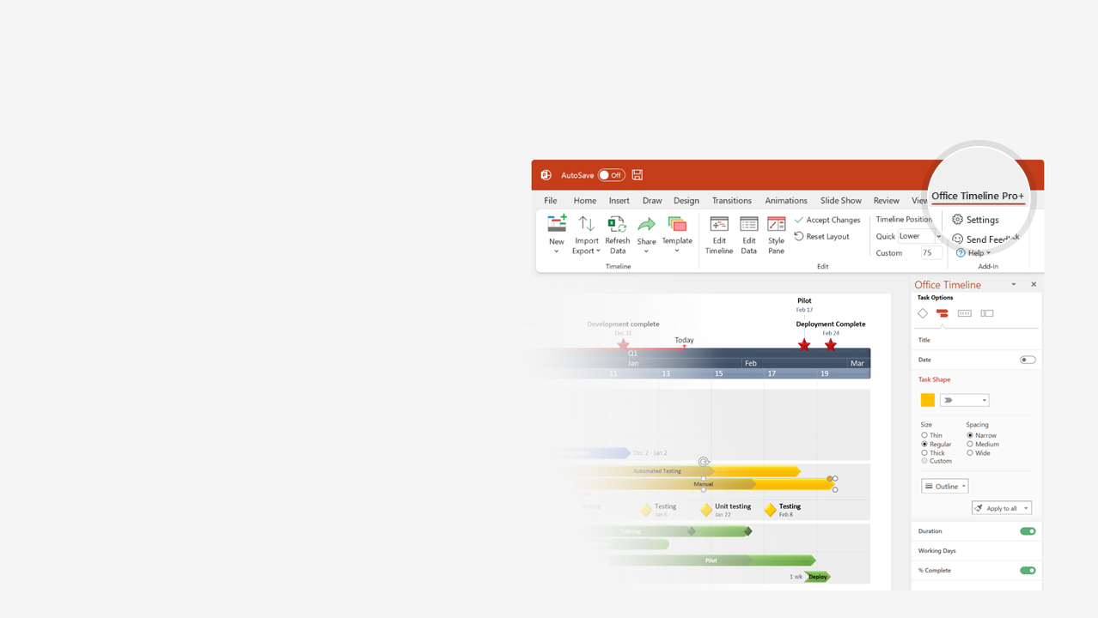

How to update this template in seconds
The Office Timeline add-in for PowerPoint will help you edit it with just a few clicks.
Get your free 14-day trial of Office Timeline here:
https://www.officetimeline.com/office-timeline/14-days-trial
Re-open this template, and create your impressive
PowerPoint visual in 3 easy steps:
1
Click the Edit Data button on the Office Timeline tab.
2
Use the Data and Timeline views to edit swimlanes, milestones and tasks.
3
Click Save to instantly update the template.

Slide 2
Auto-generated PowerPoint swimlane diagram
Patient arrives
Patient leaves
Day 1
No
2
Yes
Patient
Arrives
at hospital
Leaves
hospital
NP
Triage
Doctor
needed?
Treat
patient
Nurse
Prepare
patient
Instruct
patient
Discharge
Doctor
Treat
patient
EHR
Retrieve
patient record
Update
patient record

