Slide 1
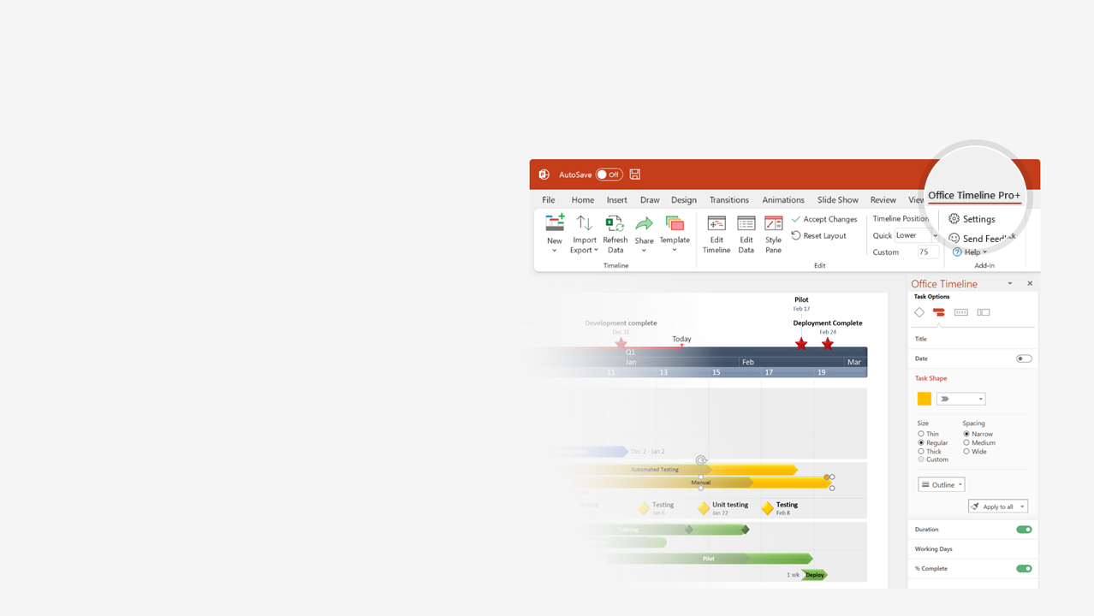

How to update this template in seconds
The Office Timeline add-in for PowerPoint will help you edit it with just a few clicks.
Get your free 14-day trial of Office Timeline here: https://www.officetimeline.com/office-timeline/14-days-trial Re-open this template, and create your impressive PowerPoint visual in 3 easy steps:
1
Click the Edit Data button on the Office Timeline tab.
2
Use the Data and Timeline views to edit swimlanes, milestones and tasks.
3
Click Save to instantly update the template.

Slide 2
Auto-generated swimlane diagram with Office Timeline
Report
Test
File
Fix
Close
5-Day Maintenance Workflow
Day 1
2
3
4
5
User
Report issue
Close issue
Comms
Close issue
Tech Support
Receive issue
Open ticket
Known
issue?
Yes
Provide
solution
Request
more info
Provide
update
Yes
No
Issue
reproduced?
No
No
Testing
Issue testing
Resolved?
Yes
Development
Bug filing
Feasibility
assessment
Fix and test

