Slide 1
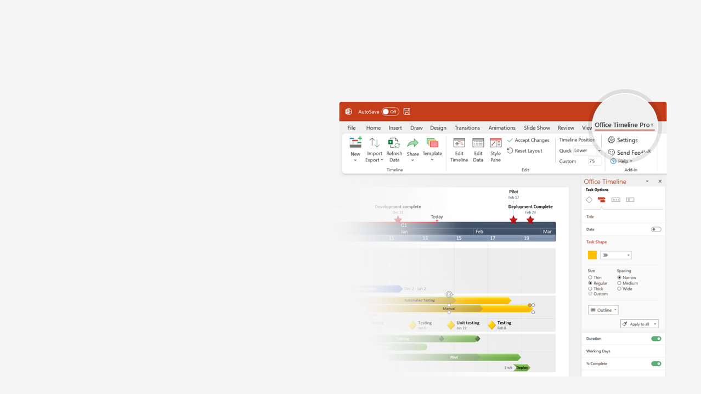

How to update this template in seconds
The Office Timeline add-in for PowerPoint will help you edit it with just a few clicks.
Get your free 14-day trial of Office Timeline here: https://www.officetimeline.com/office-timeline/14-days-trial Re-open this template, and create your impressive PowerPoint visual in 3 easy steps:
1
Click the Edit Data button on the Office Timeline tab.
2
Use the Data and Timeline views to edit swimlanes, milestones and tasks.
3
Click Save to instantly update the template.

Slide 2
Product Roadmap
U1 Check
Update 1
60%
U2 Check
Update 2
20%
U3 Check
Update 3
0%
EOY1 Assessment
EOY2 Assessment
Final Release
EOY3 Assessment
2021
2022
2023
Q4
Q1
Q2
Q3
Q4
Q1
Q2
Q3
Q4
Checkpoint V1
Dev V1
Dev V1
DEV PROJECT
Requirements
Design
Development
Testing
Deploy
Checkpoint V2
Dev V2
Dev V2
Requirements
Design
Development
Testing
Deploy
Android
P1
P2
P3
P4
P5
MOBILE
P1
P2
P3
P4
P5
iOS
Checkpoint 1
Checkpoint 2
MARKETING
Lead generation
Channel outreach
Launch
Content publishing

