Slide 1
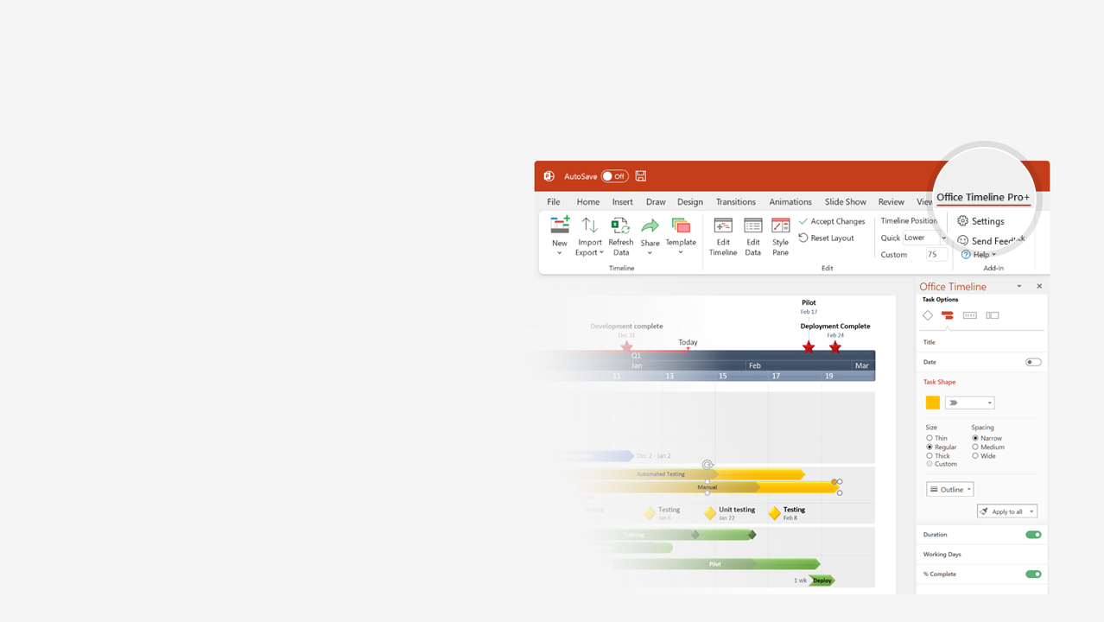

How to update this template in seconds
The Office Timeline add-in for PowerPoint will help you edit it with just a few clicks.
Get your free 14-day trial of Office Timeline here:
https://www.officetimeline.com/office-timeline/14-days-trial
Re-open this template, and create your impressive
PowerPoint visual in 3 easy steps:
1
Click the Edit Data button on the Office Timeline tab.
2
Use the Data and Timeline views to edit swimlanes, milestones and tasks.
3
Click Save to instantly update the template.

Slide 2
Jun 1 - Aug 31
Jun 1 - Aug 17
Jun 1 - Oct 22
Jun 1 - Jan 13
Jun 1 - Aug 31
Jun 1 - Aug 31
Jun 1 - Dec 10
Jun 1 - Aug 31
Jun 1 - Aug 31
Jun 1 - Oct 17
Jun 1 - Aug 31
Jun 1 - Feb 24
Jun 1 - Oct 13
Jun 1 - Oct 24
Jun 1 - Aug 31
Jun 1 - Aug 31
Mar 1 - Aug 31
Milestone
Milestone
Milestone
Milestone
Milestone
Milestone
Milestone
Milestone
Jun 1 - Oct 9
Aug 2 - Apr 1
Aug 5 - Jan 9
2016
Today
2021
Basic Balanced Scorecard Template
COMPANY NAME
ADDRESS |  | CITY |  | STATE |  | ZIP
2016
2017
2018
2019
2020
2021
Measures | Targets | Initiatives
4.2 years
Strategic objective
85%
Measure | Target | Initiative
Measure | Target | Initiative
Measure | Target | Initiative
Measure | Target | Initiative
Measure | Target | Initiative
3.2 years
Strategic objective
70%
Aug 17
FINANCIAL
4.4 years
Strategic objective
Oct 8
90%
3.6 years
Strategic objective
60%
4.2 years
Strategic objective
97%
4.2 years
Strategic objective
Aug 17
90%
Measure | Target | Initiative
Measure | Target | Initiative
Measure | Target | Initiative
Measure | Target | Initiative
Measure | Target | Initiative
4.5 years
Strategic objective
98%
CUSTOMER
4.2 years
Strategic objective
Aug 17
85%
4.2 years
Strategic objective
85%
4.4 years
Strategic objective
90%
Aug 17
Measure | Target | Initiative
Measure | Target | Initiative
Measure | Target | Initiative
Measure | Target | Initiative
Measure | Target | Initiative
4.2 years
Strategic objective
75%
INTERNAL
PROCESSES
3.7 years
Strategic objective
55%
4.4 years
Strategic objective
85%
4.4 years
Strategic objective
85%
4.2 years
Strategic objective
70%
4.2 years
Strategic objective
60%
Measure | Target | Initiative
Measure | Target | Initiative
Measure | Target | Initiative
Measure | Target | Initiative
Measure | Target | Initiative
4.4 years
Strategic objective
Oct 5
92%
LEARNING
& GROWTH
3.5 years
Strategic objective
85%
3.7 years
Strategic objective
80%
3.4 years
Strategic objective
75%
Sep 25
Aug 17

