Slide 1
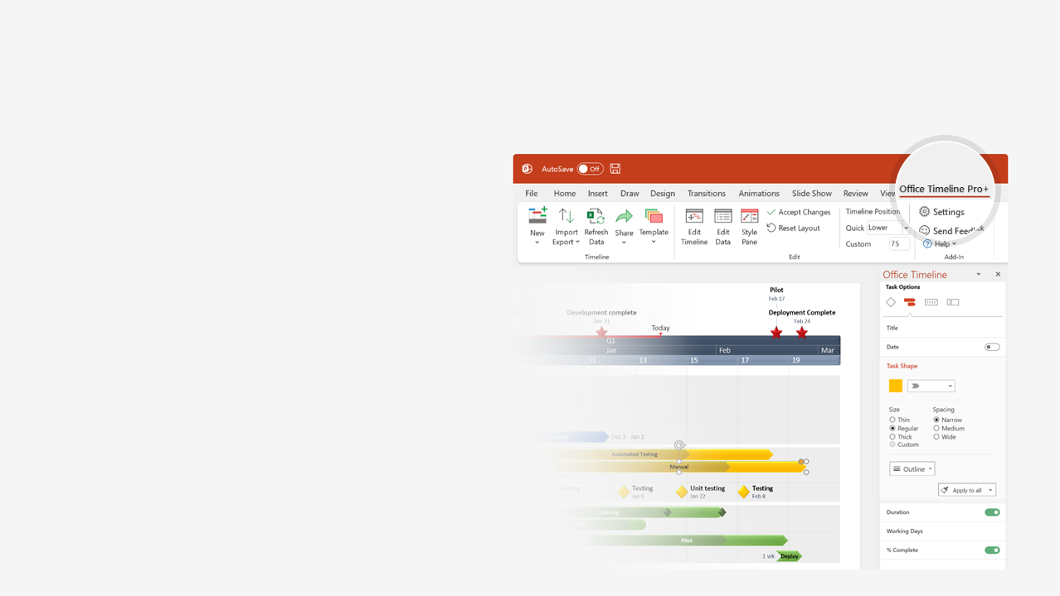
How to update this template in seconds
The Office Timeline add-in for PowerPoint will help you edit it with just a few clicks.
Get your free 14-day trial of Office Timeline here: https://www.officetimeline.com/14-days-trial Re-open this template, and create your impressive PowerPoint visual in 3 easy steps:
1
Click the Edit Data button on the Office Timeline tab.
2
Use the Data and Timeline views to edit swimlanes, milestones and tasks.
3
Click Save to instantly update the template.

Slide 2
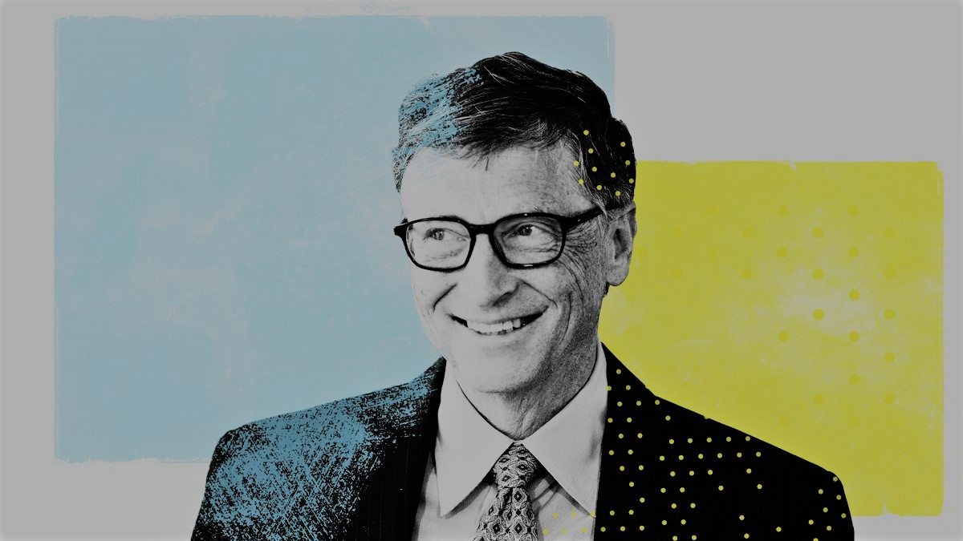
1955
2026
Today
Bill & Melinda Gates Foundation
2000
Bill Gates timeline
Donates for healthcare in India
2008
Co-founds The Giving Pledge
2010
Reinvent the Toilet Challenge
2011
Polio eradication initiative
2013
Health innovation partnership
2023
Enrolls at Lakeside School
Business @ the Speed of Thought (book)
Steps down as chairman of the board
1968
IBM partnership
1980
Marries Melinda French
1999
2014
Drops out of college & co-founds Microsoft
Becomes youngest billionaire
Person of the Year - Time
Breakthrough Energy Ventures
Bill Gates' 70th birthday
William Henry Gates III is born
1994
2025
Oct 28, 1955
1975
1986
2005
2015
1955
1961
1967
1973
1979
1985
1991
1997
2003
2009
2015
2021
1973
2000
2019
Enrolls at Harvard College
1989
Steps down as CEO of Microsoft
Inside Bill’s Brain: Decoding Bill Gates (documentary)
1981
Founds Corbis
2007
Becomes president of Microsoft
1995
Honorary degree from Harvard
2021
The Road Ahead (book)
Divorce
2006
The Morgan Global Humanitarian Award
2010
The Silver Buffalo Award
2015
The Padma Bhushan award
2016
Presidential Medal of Freedom
2017
Legion of Honor - France

