Slide 1
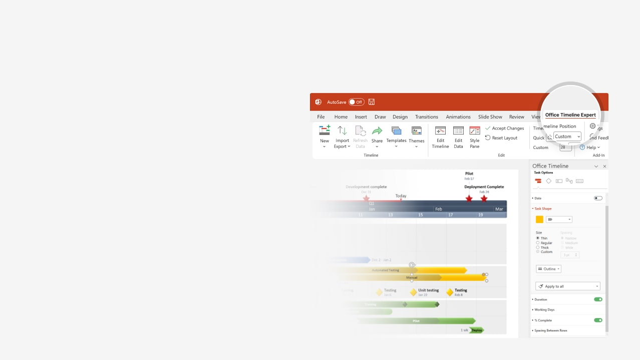

How to update this template in seconds
The Office Timeline add-in for PowerPoint will help you edit it with just a few clicks.
Get your free 14-day trial of Office Timeline here:
https://www.officetimeline.com/office-timeline/14-days-trial
Re-open this template, and create your impressive
PowerPoint visual in 3 easy steps:
1
Click the Edit Data button on the Office Timeline tab.
2
Use the Data and Timeline views to edit swimlanes, milestones and tasks.
3
Click Save to instantly update the template.

Slide 2

Business Continuity Plan
Key activities and planning for risk mitigation
Orientation exercises
Training for BC team
Testing
2025
Week 1
3
5
7
9
11
13
Instructional Workshop
Team roles
Incident Commander:
Adele Goodwin
HR/PR Officer:
Sheila Major
Information Technology:
Liam Benitez
Finance/Admin:
Violet Horton
Legal/Contracts:
Erik Mullen
Business Impact Analysis
6 days
Send out questionnaire
Develop Questionnaire
Review forms
Receive forms
5 days
5 days
4 days
Follow-up interviews
Document requirements
Recovery
Strategies
10 days
3 days
Conduct gap analysis
Management approval
Explore recovery strategies
5 days
6.6 days
Implement recovery strategy
Management approval
Plan
Development
Develop plan framework
8 days
7 days
Document procedures
Relocation Plans
4 days
IT disaster recovery plan
5 days
Organize recovery teams
25 days
Document test results
Testing & Exercise
Requirements discovery
10 days
7 days
7 days
4 days
Training
Update BC plan

