Slide 1
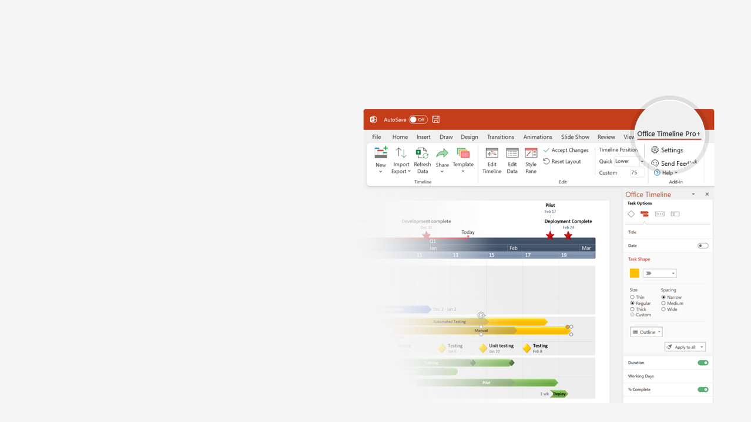

How to update this template in seconds
The Office Timeline add-in for PowerPoint will help you edit it with just a few clicks.
Get your free 14-day trial of Office Timeline here:
https://www.officetimeline.com/office-timeline/14-days-trial
Re-open this template, and create your impressive
PowerPoint visual in 3 easy steps:
1
Click the Edit Data button on the Office Timeline tab.
2
Use the Data and Timeline views to edit swimlanes, milestones and tasks.
3
Click Save to instantly update the template.

Slide 2
Clinical Trial Roadmap
COPA Human Trials in USA
Patients Recruited
Jan 15, 2020
Patients Enrolled
Patients Recruited
Mar 1, 2020
Nov 15, 2020
Study Kick-off
Patients Enrolled
Study Kick-off
Apr 1, 2020
Dec 15, 2020
Mar 15, 2021
Phase I Trial
Phase II Trial
Jan 2020 - Oct 2020
Nov 2020 - Sep 2021
10 mons
11 mons
Phase III Trial
May 31 - Nov 30
6 mons
2020
Jan
Mar
May
Jul
Sep
Nov
2021
Mar
May
Jul
Sep
Nov
2021
Oct 15, 2020
May 31, 2021
Sep 30, 2021
Nov 30, 2021
Report
Apply for Drug Approval
Report
Estimated Drug Approval Date
Phase I | USA | 30
Phase II | North America | 2,000
Phase III | Rest of the World | 10,000
Phase I Confidential
Phase II & III Public Announcements

