Slide 1
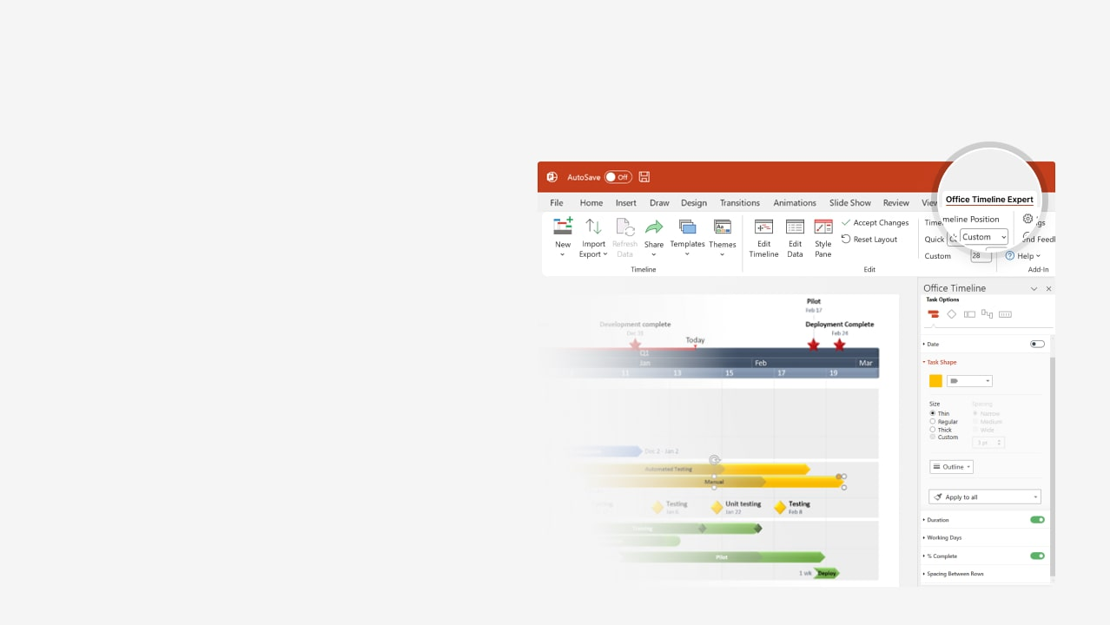
How to update this template in seconds
The Office Timeline add-in for PowerPoint will help you edit it with just a few clicks.
Get your free 14-day trial of Office Timeline here: https://www.officetimeline.com/office-timeline/14-days-trial Re-open this template, and create your impressive PowerPoint visual in 3 easy steps:
1
Click the Edit Data button on the Office Timeline tab.
2
Use the Data and Timeline views to edit swimlanes, milestones and tasks.
3
Click Save to instantly update the template.

Slide 2
Clinical Trial Roadmap
COPA Human Trials in USA
Patients Recruited
Jan 15, 2025
Patients Enrolled
Patients Recruited
Mar 1, 2025
Nov 15, 2025
Study Kick-off
Patients Enrolled
Study Kick-off
Apr 1, 2025
Dec 15, 2025
Mar 15, 2026
Phase I Trial
Phase II Trial
11 mons
Jan 2025 - Oct 2025
Nov 2025 - Sep 2026
Phase III Trial
6 mons
May 31 - Nov 30
2025
Jan
Mar
May
Jul
Sep
Nov
2026
Mar
May
Jul
Sep
Nov
2026
Oct 15, 2025
May 31, 2026
Sep 30, 2026
Nov 30, 2026
Report
Apply for Drug Approval
Report
Estimated Drug Approval Date

