Slide 1
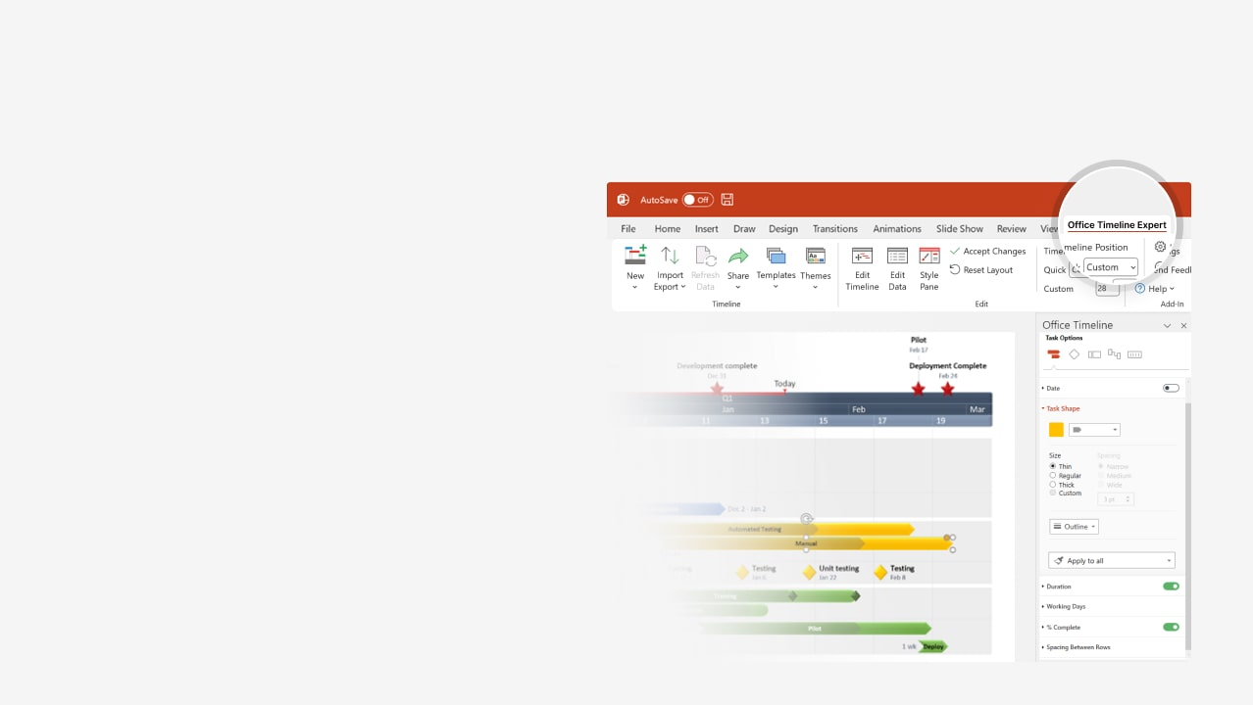

How to update this template in seconds
The Office Timeline add-in for PowerPoint will help you edit it with just a few clicks.
Get your free 14-day trial of Office Timeline here:
https://www.officetimeline.com/office-timeline/14-days-trial
Re-open this template, and create your impressive
PowerPoint visual in 3 easy steps:
1
Click the Edit Data button on the Office Timeline tab.
2
Use the Data and Timeline views to edit swimlanes, milestones and tasks.
3
Click Save to instantly update the template.

Slide 2

Construction building
Mar
Apr
May
Jun
Jul
Aug
2026
2
3
4
5
6
7
8
9
10
11
12
13
14
15
16
17
18
19
20
21
22
23
24
25
26
Site survey and land inspection
Site clearing & excavation
Surveying & site prep
Mar 1 - Mar 3
Site clearing and excavation
Mar 3 - Mar 11
Foundation pour
Concrete foundation
Foundation curing
Pour foundation concrete
Mar 11 - Mar 14
Structural framing
Mar 11 - Mar 26
Install steel framing
Steel framing
Mar 26 - Apr 10
Frame building structure
Mechanical & electrical systems
Electrical systems
Apr 1 - Apr 15
Install electrical wiring
Apr 5 - Apr 15
Install plumbing systems
HVAC systems
Apr 10 - Apr 20
Install HVAC systems
Roofing
May 1 - May 15
Install roof structure
Roofing & glazing
Final inspection of roofing & glazing
Glazing
May 15 - Jun 1
Install windows and glazing
Drywall & insulation
Jun 1 - Jun 15
Install drywall and insulation
Interior construction
Jun 10 - Jun 20
Paint interior walls and ceilings
Flooring
Jun 15 - Jul 3
Install flooring
Exterior finishing
Exterior painting
Final exterior inspection
Jul 1 - Jul 15
Exterior painting and finishing
Final inspection
Approval
First inspection
Sign-off

Slide 3

Renovation timeline
Demolition completed
First inspection
Final walkthrough and approval
Today
Aug 26
Dec 22
Jan 16
2025
2026
Aug
Sep
Oct
Nov
Dec
Jan
2026
2
3
4
5
6
7
8
9
10
11
12
13
14
15
16
17
18
19
20
21
22
23
24
Site survey and inspection
Site preparation
Aug 3 - Aug 4
100%
Site clearance
Aug 5 - Aug 13
Demolition
60%
Demolition
Aug 14 - Aug 26
Framing & structural work
Sep 4 - Sep 15
0%
Frame building structure
Sep 23 - Oct 12
0%
Install structural components
Electrical & plumbing
Oct 20 - Oct 31
0%
Rough-in electrical wiring
Oct 22 - Nov 10
0%
Rough-in plumbing
Nov 15 - Nov 25
0%
Install fixtures & connections
Dec 1 - Dec 15
0%
Install drywall & insulation
Dec 16 - Dec 22
0%
Paint interior walls & ceilings
Interior finishing
Jan 10 - Jan 15
0%
Flooring installation

Slide 4
Infrastructure roadmap
Site handover to contractor
Final handover to client
Mar 1
Jul 9
Mar
Apr
May
Jun
Jul
2026
2
3
4
5
6
7
8
9
10
11
12
13
14
15
16
17
18
19
Survey land and site inspection
Land surveying
Surveying
Mar 1 - Mar 3
Finalize land survey
Mar 4
Excavation & groundworks
Excavation
Mar 6 - Mar 16
Begin excavation and site preparation
Groundworks
Mar 17 - Mar 23
Complete groundwork and trenching
Piling & foundations
Foundation piling
Install piling and foundations
Mar 21 - Apr 5
Foundation curing and inspections
Apr 6
Preparation
Apr 10 - Apr 15
Pour concrete foundation
Concrete works
Pouring
Apr 16 - Apr 27
Pour slabs and supports
Curing & inspection
Apr 25 - May 5
Concrete curing and structural inspection
Road work & paving
Excavation
May 6 - May 18
Begin excavation for road base
Road paving
May 15 - Jun 4
Lay asphalt and road surfacing
Excavation
Jun 4 - Jun 10
Dig trenches for utility lines
Utilities installation
Install water, gas, and electric lines
Installation
Jun 10 - Jun 20
Jun 21
Inspect utility installations
Inspection & handover
Final inspections
Jun 29 - Jul 5
Final site inspections

