Slide 1
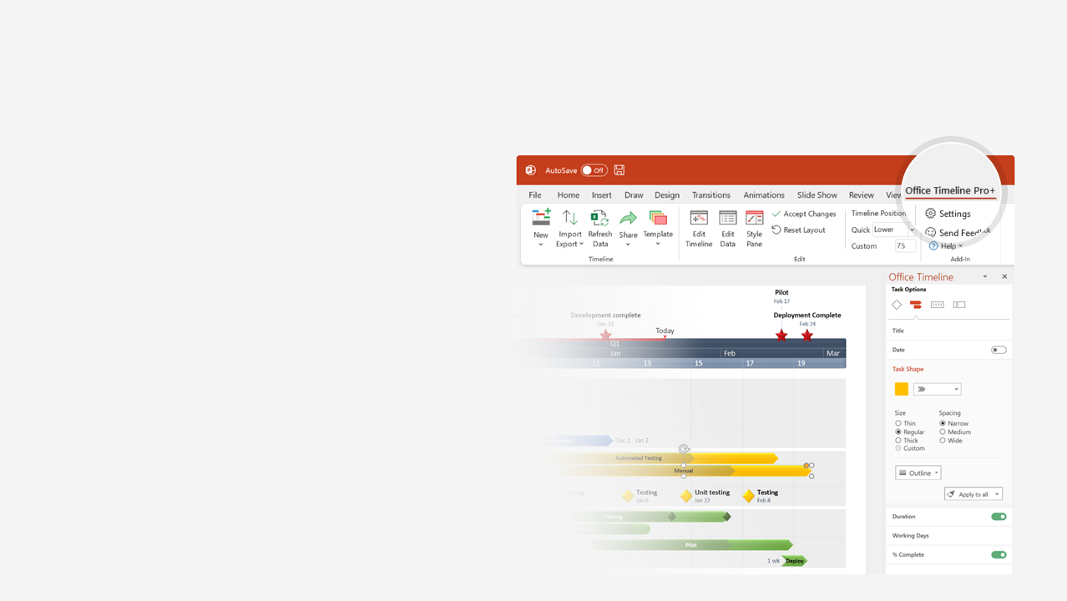
How to update this template in seconds
The Office Timeline add-in for PowerPoint will help you edit it with just a few clicks.
Get your free 14-day trial of Office Timeline here: https://www.officetimeline.com/office-timeline/14-days-trial Re-open this template, and create your impressive PowerPoint visual in 3 easy steps:
1
Click the Edit Data button on the Office Timeline tab.
2
Use the Data and Timeline views to edit swimlanes, milestones and tasks.
3
Click Save to instantly update the template.

Slide 2
Court timeline template
911 call from shooting witness reporting gunfire at 700 Block Oswego Rd
13:30
Officers report gunshot victim behind building, no suspect found
13:45
Air unit called in for search
13:53
Suspect detained after ground chase at 740 Cedar Ave
First officers arrive on scene
13:34
14:19
Jan 24
13:00
14:00
13:49
14:27
13:31
Victim carried to EMS
Shooting witness escorted to scene positively identifies suspect
Police dispatched
14:12
Suspect matching shooting witness description identified at Wingfoot Park
13:39
Shooting witness questioned on scene, gives full description of suspect

