Slide 1
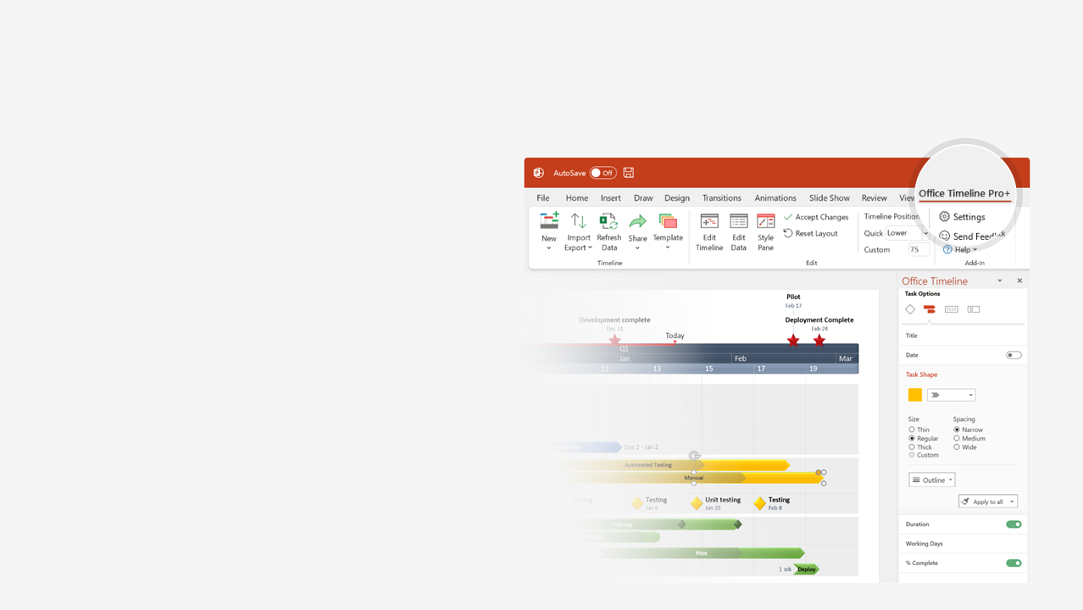
How to update this template in seconds
The Office Timeline add-in for PowerPoint will help you edit it with just a few clicks.
Get your free 14-day trial of Office Timeline here: https://www.officetimeline.com/14-days-trial Re-open this template, and create your impressive PowerPoint visual in 3 easy steps:
1
Click the Edit Data button on the Office Timeline tab.
2
Use the Data and Timeline views to edit swimlanes, milestones and tasks.
3
Click Save to instantly update the template.

Slide 2
Crime timeline template
Tommy Smyth seen at Willowpoint Public Library, 175 miles from Graslin
Smyth and Andy Borton take cell phone picture at Pickering Dairy Queen, 200 miles from Graslin
Smyth receives a speeding ticket 20 miles south of Pickering
4:30 pm
7:05 pm
12:20 am
May 16
4 pm
5 pm
6 pm
7 pm
8 pm
9 pm
10 pm
11 pm
12 am
1 am
May 17
7:29 pm
Emanuel Spizer checks into Desert Motel in Graslin
8:22 pm
Guest in next door room reports shouting
7:30 pm - 9:30 pm
9:30 pm - 2 am
Time of assault
Motel guest in neighboring room hears no disturbances the rest of the night

