Slide 1
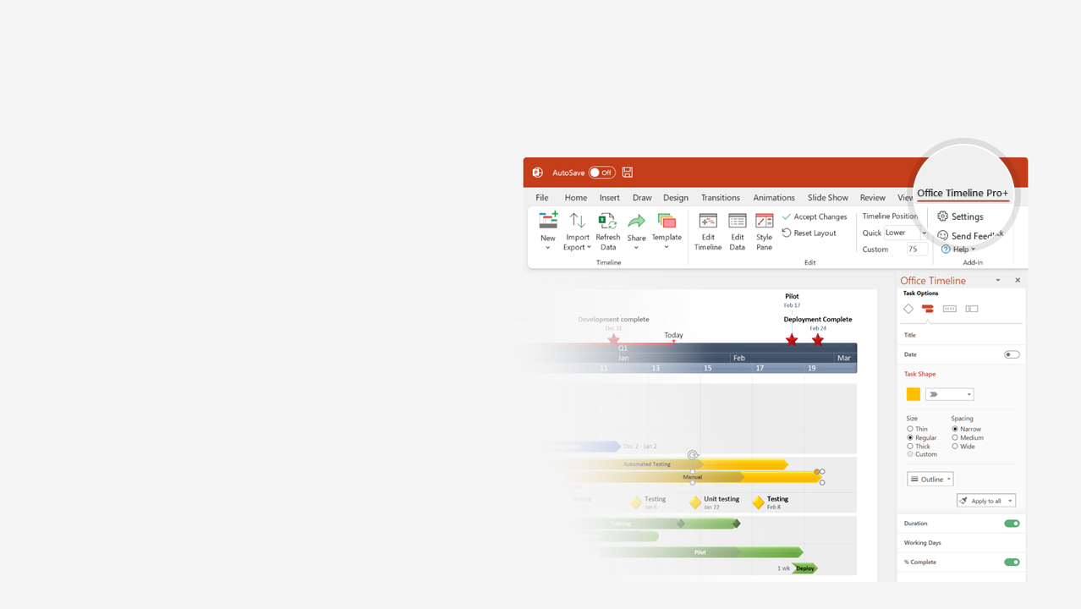

How to update this template in seconds
The Office Timeline add-in for PowerPoint will help you edit it with just a few clicks.
Get your free 14-day trial of Office Timeline here: https://www.officetimeline.com/14-days-trial Re-open this template, and create your impressive PowerPoint visual in 3 easy steps:
1
Click the Edit Data button on the Office Timeline tab.
2
Use the Data and Timeline views to edit swimlanes, milestones and tasks.
3
Click Save to instantly update the template.

Slide 2
Critical path tracker template
Day 1
5
9
13
17
21
25
29
Thu
Mon
Fri
Tue
Sat
Wed
Sun
Thu
Kick-off
Project start
Sep 1
Task 1
4 days
Task 2
3 days
Phase 1
Team 1
Milestone
Task 6
8 days
Team 2
Task 3
3 days
Phase 2
Task 4
4 days
Team 3
Milestone
4 days
Task 7
Task 8
8 days
Phase 3
Team 4
Milestone
Task 9
8 days
Task 5
6 days
Review
Milestone
Project end
Task 10
5 days
Sep 28

