Slide 1
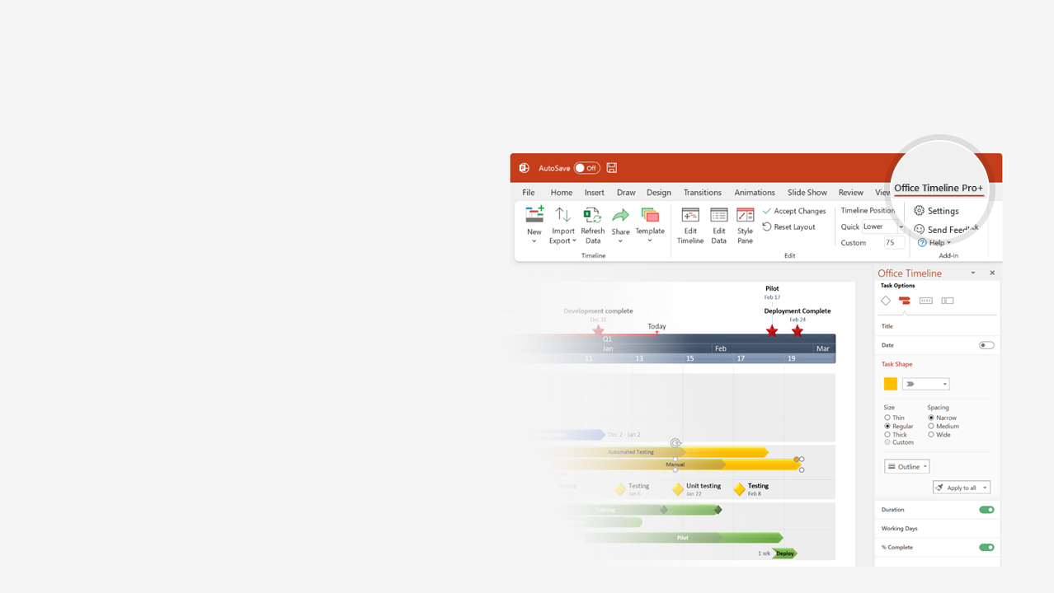

How to update this template in seconds
The Office Timeline add-in for PowerPoint will help you edit it with just a few clicks.
Get your free 14-day trial of Office Timeline here:
https://www.officetimeline.com/office-timeline/14-days-trial
Re-open this template, and create your impressive
PowerPoint visual in 3 easy steps:
1
Click the Edit Data button on the Office Timeline tab.
2
Use the Data and Timeline views to edit swimlanes, milestones and tasks.
3
Click Save to instantly update the template.

Slide 2
Cross-functional Swimlane Flowchart
Planning Checkin
Planning Checkin
Planning Checkin
October 20, 2025
October 20, 2025
October 20, 2025
August 18, 2025
Jun 30 - Aug 21
Aug 18 - Oct 21
August 1, 2025
August 2, 2025
August 2, 2025
Apr 1 - May 13
June 30, 2025
June 19, 2025
July 10, 2025
May 29, 2025
24.1 days
37.2 days
45.4 days
2025
Today
Product Development & Launch
Executive Review
Project Kickoff
Mar 10, 2025
Executive Decision
Final Release
Jan 25, 2025
Mar 21, 2025
Oct 20, 2025
Jan
Feb
Mar
Apr
May
Jun
Jul
Aug
Sep
Oct
2025
42 days
55 days
Assemble Resources
Subcontractor Selection
Planning
Jan 1 - Mar 2
Mar 1 - May 16
Content Plan
45 days
Planning R2 Begin
May 17 - Jul 20
30 days
Mar 1 - Apr 4
Prototype
Alpha
Product Development
145 days
Apr 1 - Oct 21
Development
Integration
Integration
Performance Validation
Phase Sync
RTW Deployment
Marketing
Press Release
Public Website Live
Beta Blog Launch
WW Launch Event

