Slide 1
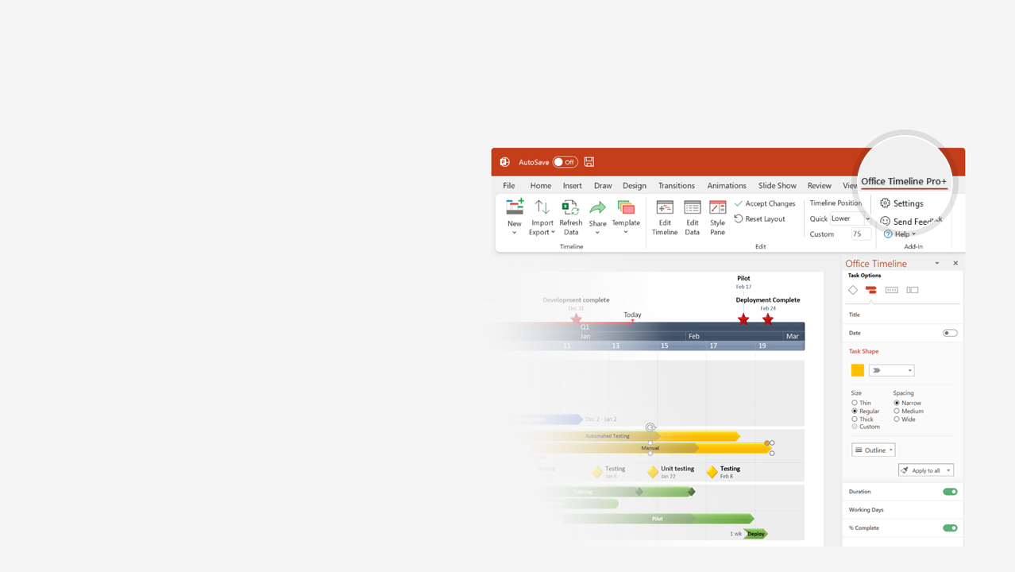

How to update this template in seconds
The Office Timeline add-in for PowerPoint will help you edit it with just a few clicks.
Get your free 14-day trial of Office Timeline here:
https://www.officetimeline.com/office-timeline/14-days-trial
Re-open this template, and create your impressive
PowerPoint visual in 3 easy steps:
1
Click the Edit Data button on the Office Timeline tab.
2
Use the Data and Timeline views to edit swimlanes, milestones and tasks.
3
Click Save to instantly update the template.

Slide 2
E-Comm Program Roadmap
Overview of Projects, Teams & Activities
Mobile Apps in Stores
February 14, 2022
Project Sponsored
E-Comm Site Live
Real-Time Transactions Live
May 1, 2021
November 30, 2021
March 4, 2022
2021
2022
Q2
Q3
Q4
Q1
2022
May
Jun
Jul
Aug
Sep
Oct
Nov
Dec
Jan
Feb
Mar
Milestones
Framework Update
Purchasing Beta
Mobile Refresh
Owners:
E-comm
Adele Goodwin
Accounts
Sheila Major
Mobile
Liam Benitez
Infrastructure
Violet Horton
Tracking
Erik Mullen
Reporting
Julie Smithson
Website Beta
Mobile Beta
Mobile Launch
E-comm team 1
Core pages
Purchase flow
Accounts
E-comm team 2
Secondary pages
Localization
E-comm team 3
SOC Type 2 compliance
GDPR compliance
Outsourced
SSO integration
Mobile
Outsourced
Partner integration 1
Partner integration 2
Partner integration 3
E-comm team 1
Billing management
Centralized billing
Core OS design
Core app logic
Cross platform libs
Mobile API
Push notification engine
E-Comm
Android team
Android app dev
iOS team
iOS app dev
Infrastructure
Data backbone
Cloud connect
Real-time data stream
Disaster recovery

