Slide 1
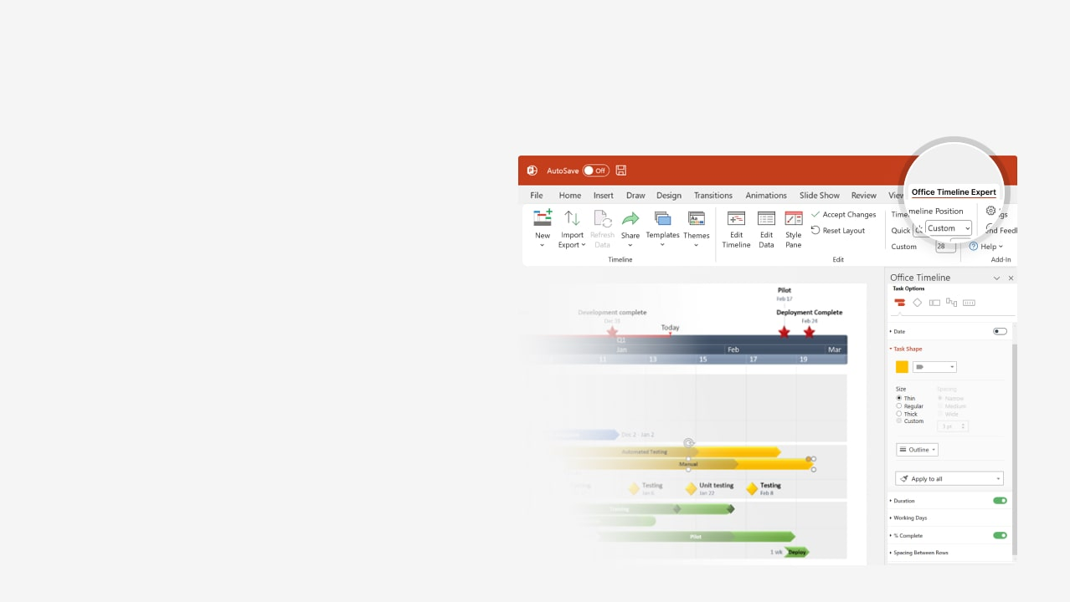
How to update this template in seconds
The Office Timeline add-in for PowerPoint will help you edit it with just a few clicks.
Get your free 14-day trial of Office Timeline here: https://www.officetimeline.com/office-timeline/14-days-trial Re-open this template, and create your impressive PowerPoint visual in 3 easy steps:
1
Click the Edit Data button on the Office Timeline tab.
2
Use the Data and Timeline views to edit swimlanes, milestones and tasks.
3
Click Save to instantly update the template.

Slide 2
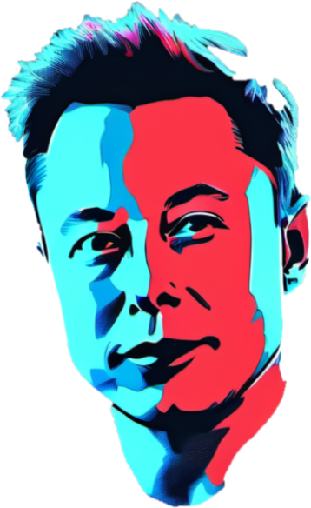
1971
2026
Today
Elon Musk timeline
Moves to Canada
Elon Reeve Musk
is born
Jan 1989
Ranks third in
Bloomberg Billionaires Index
Creates Blastar
Goes to Penn, Stanford
Becomes a U.S. citizen
Jan 1972
Jun 1983
Jan 1992
Jan 2002
Jan 2024
1971
1978
1985
1992
1999
2006
2013
2020
Marries
Justine Wilson
First
child
Damian, Saxon & Kai are born
X Æ A-12 is born
Techno
is born
Jan 2000
Xavier & Griffin are born
Jan 2002
Jan 2006
Divorces Justine
Dates Grimes
May 2020
Sep 2023
Strider &
Azure are born
Apr 2004
Marries
Talulah Riley
Jan 2008
Divorces
Talulah
Jan 2018
Nov 2021
Family life & children
Exa Dark Sideræl is born
Jan 2010
Remarries Talulah Riley
Jan 2012
Re-divorces
Talulah
Dec 2021
Jan 2013
Nov 2015
12th child is born
2024
Founds Zip2
Corporation
The Musk Foundation
Falcon 1 reaches orbit
OpenAI
Starship’s
failed flight
Jan 1995
Jan 2002
Jan 2008
Jan 2015
Apr 2023
Tesla Motors
Plans for Hyperloop
Crew Dragon
Starship’s successful flight
Sells Zip2
Jan 1999
Jan 2004
Jan 2013
Jan 2020
Career
Mar 2024
PayPal
SolarCity is founded
Neuralink,
The Boring Company
Inspiration4
Jan 2000
Jan 2006
Jan 2016
Sep 2021
Sells PayPal, Founds SpaceX
ISS docking
Falcon Heavy
Acquires
Twitter (X)
Jan 2002
Jan 2012
Jan 2018
Apr 2022

