Slide 1
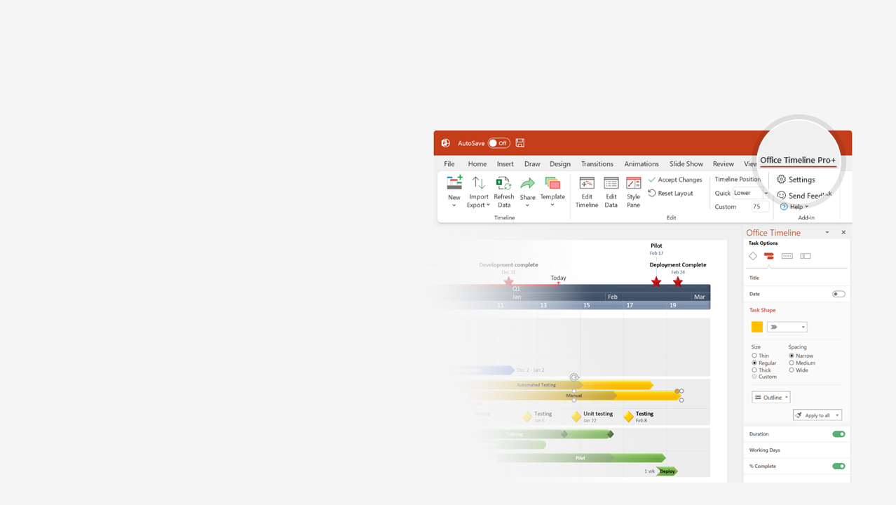

How to update this template in seconds
The Office Timeline add-in for PowerPoint will help you edit it with just a few clicks.
Get your free 14-day trial of Office Timeline here:
https://www.officetimeline.com/14-days-trial
Re-open this template, and create your impressive
PowerPoint visual in 3 easy steps:
1
Click the Edit Data button on the Office Timeline tab.
2
Use the Data and Timeline views to edit swimlanes, milestones and tasks.
3
Click Save to instantly update the template.

Slide 2

38 days
47 days
80 days
33 days
23 days
20 days
2022
2023
Today
Event Planning Timeline Template
Kick-off
Event
Aug 2
Mar 20
Aug
Sep
Oct
Nov
Dec
Jan
Feb
Mar
Week 1
6
11
16
21
26
31
Day 1
28
55
82
109
136
163
190
217
Milestone 1
Milestone 2
Milestone 3
Milestone 4
Stage I
Aug 19
Sep 27
Oct 22
Nov 30
Activity A
Activity B
Aug 13 - Oct 5
Oct 6 - Dec 9
event-planning-template
event-planning-template
Milestone 5
Stage II
Dec 22
Oct 15 - Feb 3
Activity C
Milestone 6
Milestone 7
Stage III
Dec 27
Feb 8
Nov 16 - Dec 31
Activity D
Activity E
Jan 11 - Feb 11
Milestone 8
Stage IV
Feb 26
Feb 1 - Feb 28
Activity F

