Slide 1
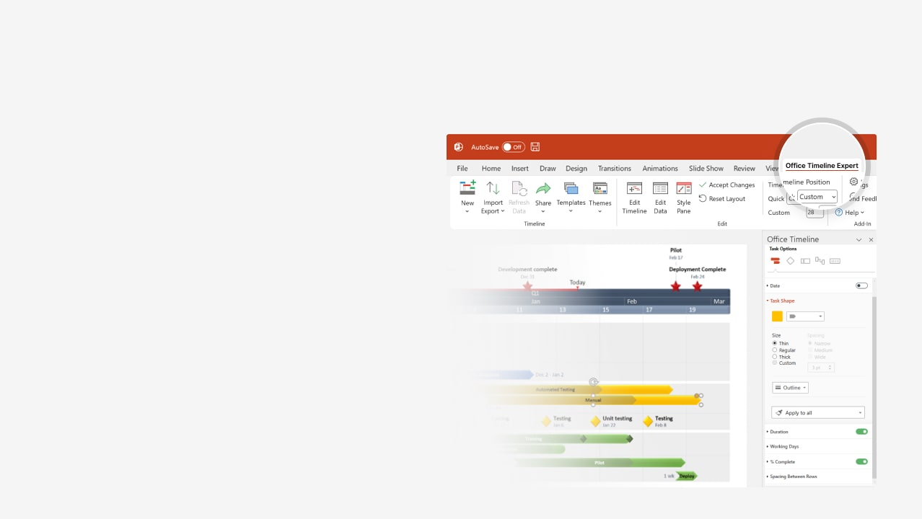

How to update this template in seconds
The Office Timeline add-in for PowerPoint will help you edit it with just a few clicks.
Get your free 14-day trial of Office Timeline here: https://www.officetimeline.com/office-timeline/14-days-trial Re-open this template, and create your impressive PowerPoint visual in 3 easy steps:
1
Click the Edit Data button on the Office Timeline tab.
2
Use the Data and Timeline views to edit swimlanes, milestones and tasks.
3
Click Save to instantly update the template.

Slide 2

15 days
15 days
15 days
15 days
10 days
12 days
15 days
15 days
13 days
13 days
15 days
15 days
15 days
15 days
15 days
11 days
19 days
10 days
10 days
9 days
9 days
9 days
2025
2026
Today
Executive report Gantt chart template
Hardware & software acquisition
Data migration completed
Project kickoff
Aug 30
Integration & testing
Mar 5
Project closure
May 31
Nov 20
Jul 6
May
Jul
Sep
Nov
Jan
Mar
May
Jul
Requirements
Jun 10 - Jun 30
Infrastructure assessment
Jun 16 - Jul 6
Stakeholder interviews
Feasibility study
Jul 12 - Aug 1
Cost-benefit analysis
Planning
Aug 2 - Aug 22
Executive approval
Aug 30 - Sep 13
Identify vendors
Vendor selection
Sep 11 - Sep 26
Issue RFP
Sep 30 - Oct 20
Evaluate proposals
Oct 12 - Nov 1
Draft final contracts
Acquisition
Oct 23 - Nov 10
Hardware purchases
Oct 26 - Nov 12
Software license purchases
Infrastructure config
Nov 20 - Dec 10
Install hardware
Nov 29 - Dec 19
Configure network and security protocols
Dec 18 - Jan 7
Integrate new hardware
System integration
Dec 26 - Jan 15
Perfom compatibiilty testing
Implementation
Jan 2 - Jan 22
Conduct UAT
Data migration
Jan 23 - Feb 6
Migrate data
Feb 6 - Mar 4
Validate data integrity
Training & documentation
Mar 5 - Mar 17
Create training materials
Mar 17 - Mar 29
Conduct training sessions
Mar 17 - Mar 29
Gather feedback
Review and closure
Mar 23 - Apr 4
Complete documentation
Apr 19 - May 1
Handover to IT

