Slide 1
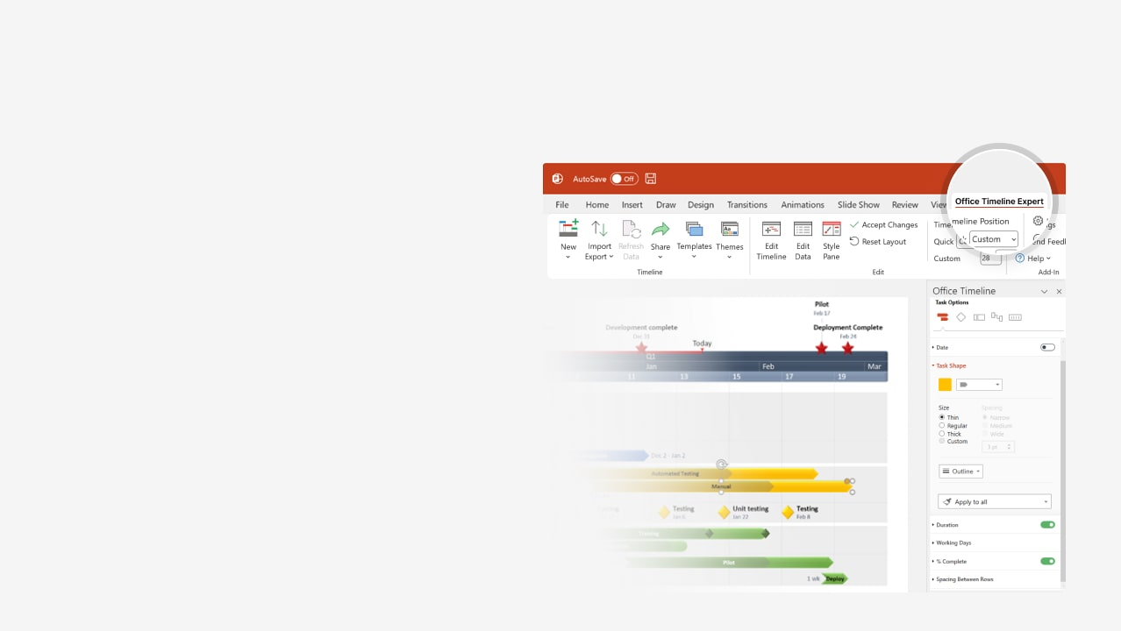

How to update this template in seconds
The Office Timeline add-in for PowerPoint will help you edit it with just a few clicks.
Get your free 14-day trial of Office Timeline here:
https://www.officetimeline.com/office-timeline/14-days-trial
Re-open this template, and create your impressive
PowerPoint visual in 3 easy steps:
1
Click the Edit Data button on the Office Timeline tab.
2
Use the Data and Timeline views to edit swimlanes, milestones and tasks.
3
Click Save to instantly update the template.

Slide 2

2025
2026
Today
Executive
report
timeline
Strategy development finalized
Customer feedback collected
Sep 1
Jan 4
Project Kickoff
Content created
Mid-campaign analysis
Campaign ended and final review
Jul 14
Oct 4
Dec 1
Feb 11
Market research completion
Campaign launched
Promotional event
Lessons learned and documented
Aug 2
Nov 2
Dec 23
Feb 25
Jul
Aug
Sep
Oct
Nov
Dec
Jan
Feb
Mar
Apr
Q3
Q4
Q1
Q2
Aug 26
Target audience defined
Market research
Aug 10
Market analysis
Aug 19
Competitors analyzed
Sep 8
Campaign planned
Strategy development
Oct 22
Marketing materials produced
Sep 23
Budget approved
Campaign launch
Nov 7
Digital marketing initiated
Nov 24
Prints and events
Feb 1
Performance evaluation
Campaign review
Report and future recommendations
Feb 18
Document key lessons
Mar 7
Documentation
Archive campaign materials
Mar 13
Post-mortem
Mar 20

