Slide 1
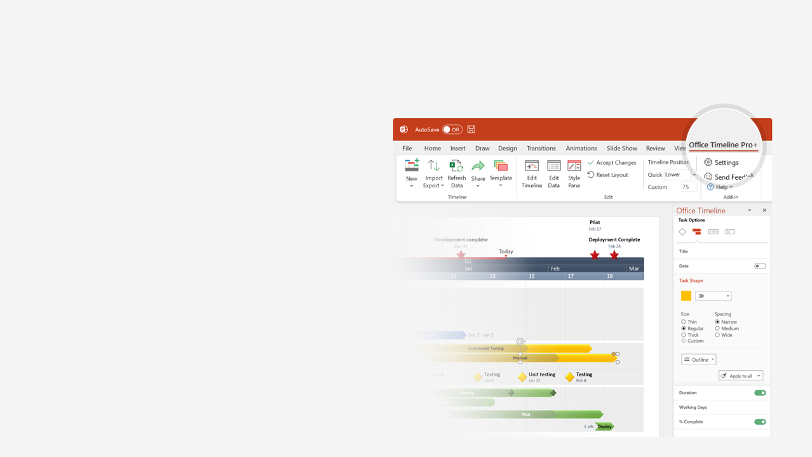
How to update this template in seconds
The Office Timeline add-in for PowerPoint will help you edit it with just a few clicks.
Get your free 14-day trial of Office Timeline here: https://www.officetimeline.com/office-timeline/14-days-trial Re-open this template, and create your impressive PowerPoint visual in 3 easy steps:
1
Click the Edit Data button on the Office Timeline tab.
2
Use the Data and Timeline views to edit swimlanes, milestones and tasks.
3
Click Save to instantly update the template.

Slide 2
2004
2007
2010
2013
2016
2019
2022
“TheFacebook” launches
Stickers
Facebook reactions
1st drop in daily users
Feb 2004
May 2013
Feb 2016
Feb 2022
facebook.com domain
"Like" button
Facebook Timeline
Community Chats
Aug 2005
Feb 2009
Sep 2011
Sep 2022
Look Back videos
Creator Studio & Business Suite
Product
Feb 2014
Feb 2023
Tagging
Featured Posts
Meta Verified launch
Dec 2005
Jan 2012
Mar 2023
News Feed is launched
Payments in Messenger
Threads
Sep 2006
Mar 2015
Jul 2023
Platform for developers
New AI Experiences
May 2007
Sep 2023
LLC is formed
Facebook goes mobile
Skype partnership
Acquires GIPHY
Apr 2004
Jan 2007
Jun 2011
May 2020
First investment: $500,000
Facebook Inc. goes public
Facebook becomes Meta
Jun 2004
May 2012
Oct 2021
Company
International HQ in Dublin
Acquires WhatsApp
Data breach exposes 530m users
Oct 2008
Feb 2014
May 2021
Acquires Instagram
Cambridge Analytica scandal
Historic job cut
Apr 2012
Mar 2018
Nov 2022
1 billion active users
EU fine
Oct 2012
May 2023

