Slide 1
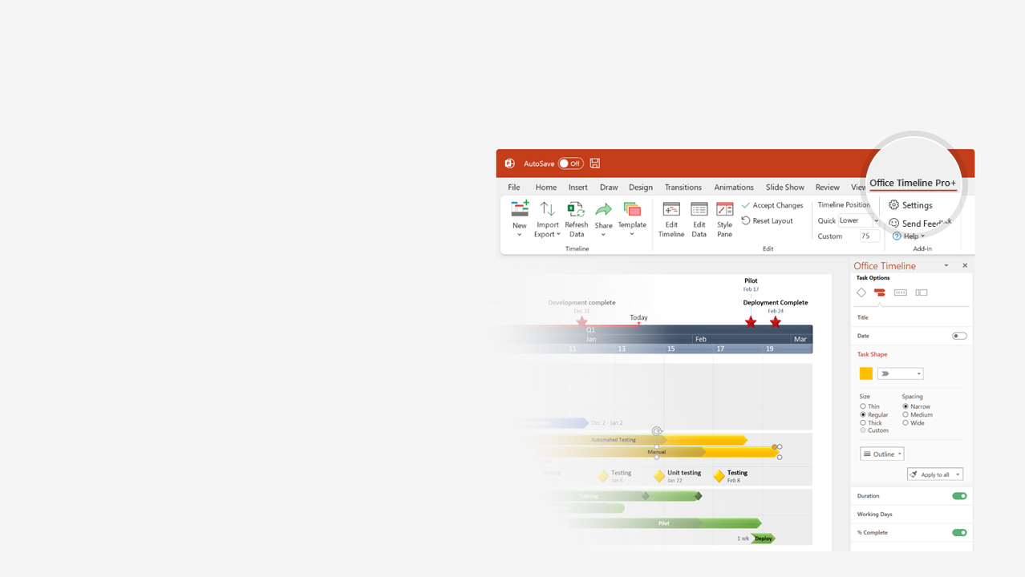

How to update this template in seconds
The Office Timeline add-in for PowerPoint will help you edit it with just a few clicks.
Get your free 14-day trial of Office Timeline here: https://www.officetimeline.com/office-timeline/14-days-trial Re-open this template, and create your impressive PowerPoint visual in 3 easy steps:
1
Click the Edit Data button on the Office Timeline tab.
2
Use the Data and Timeline views to edit swimlanes, milestones and tasks.
3
Click Save to instantly update the template.

Slide 2
Task Planner Template
2017
Feb
Mar
Apr
May
Jun
2017
35 days
Today
Thu 2/23
RDP
Wed 4/12
1 day
Mar 24
RDP Phase1
1 day
Mar 31
RDP Phase2
1 day
Apr 12
RTM Phase1
33 days
Thu 2/16
API development
Mon 4/3
1 day
Mar 15
YCFG MVP
8 days
Mar 23 - Apr 3
API-Bundle
1 day
Mar 1
OC - Consolidation
1 day
Mar 8
RTM Phase2
34 days
Sat 4/1
YC development
Thu 5/18
6 days
May 2 - May 9
Date
1 day
Apr 6
DP API Bundle
1 day
Apr 10
DP Phase4
1 day
May 8
iPackage Phase1
27 days
Wed 5/10
YC1.1
Thu 6/15
1 day
May 17
DP Phase4 (RTM)
1 day
May 17
YC1.1 (RTM)
1 day
May 24
iPackage Phase2
0 days
May 27
DP Phase5
0 days
Jun 3
WND-CDG Phase 1
1 day
Jun 14
iPackage Phase3

