Slide 1
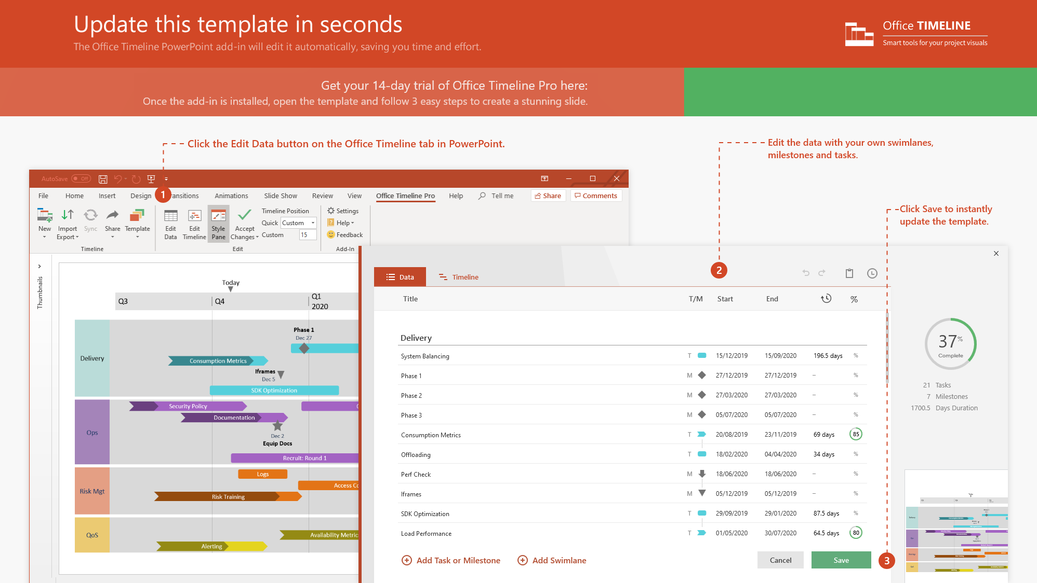
https://www.officetimeline.com/14-days-trial

Slide 2
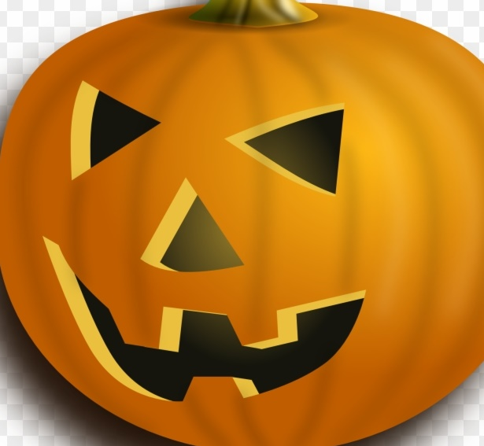
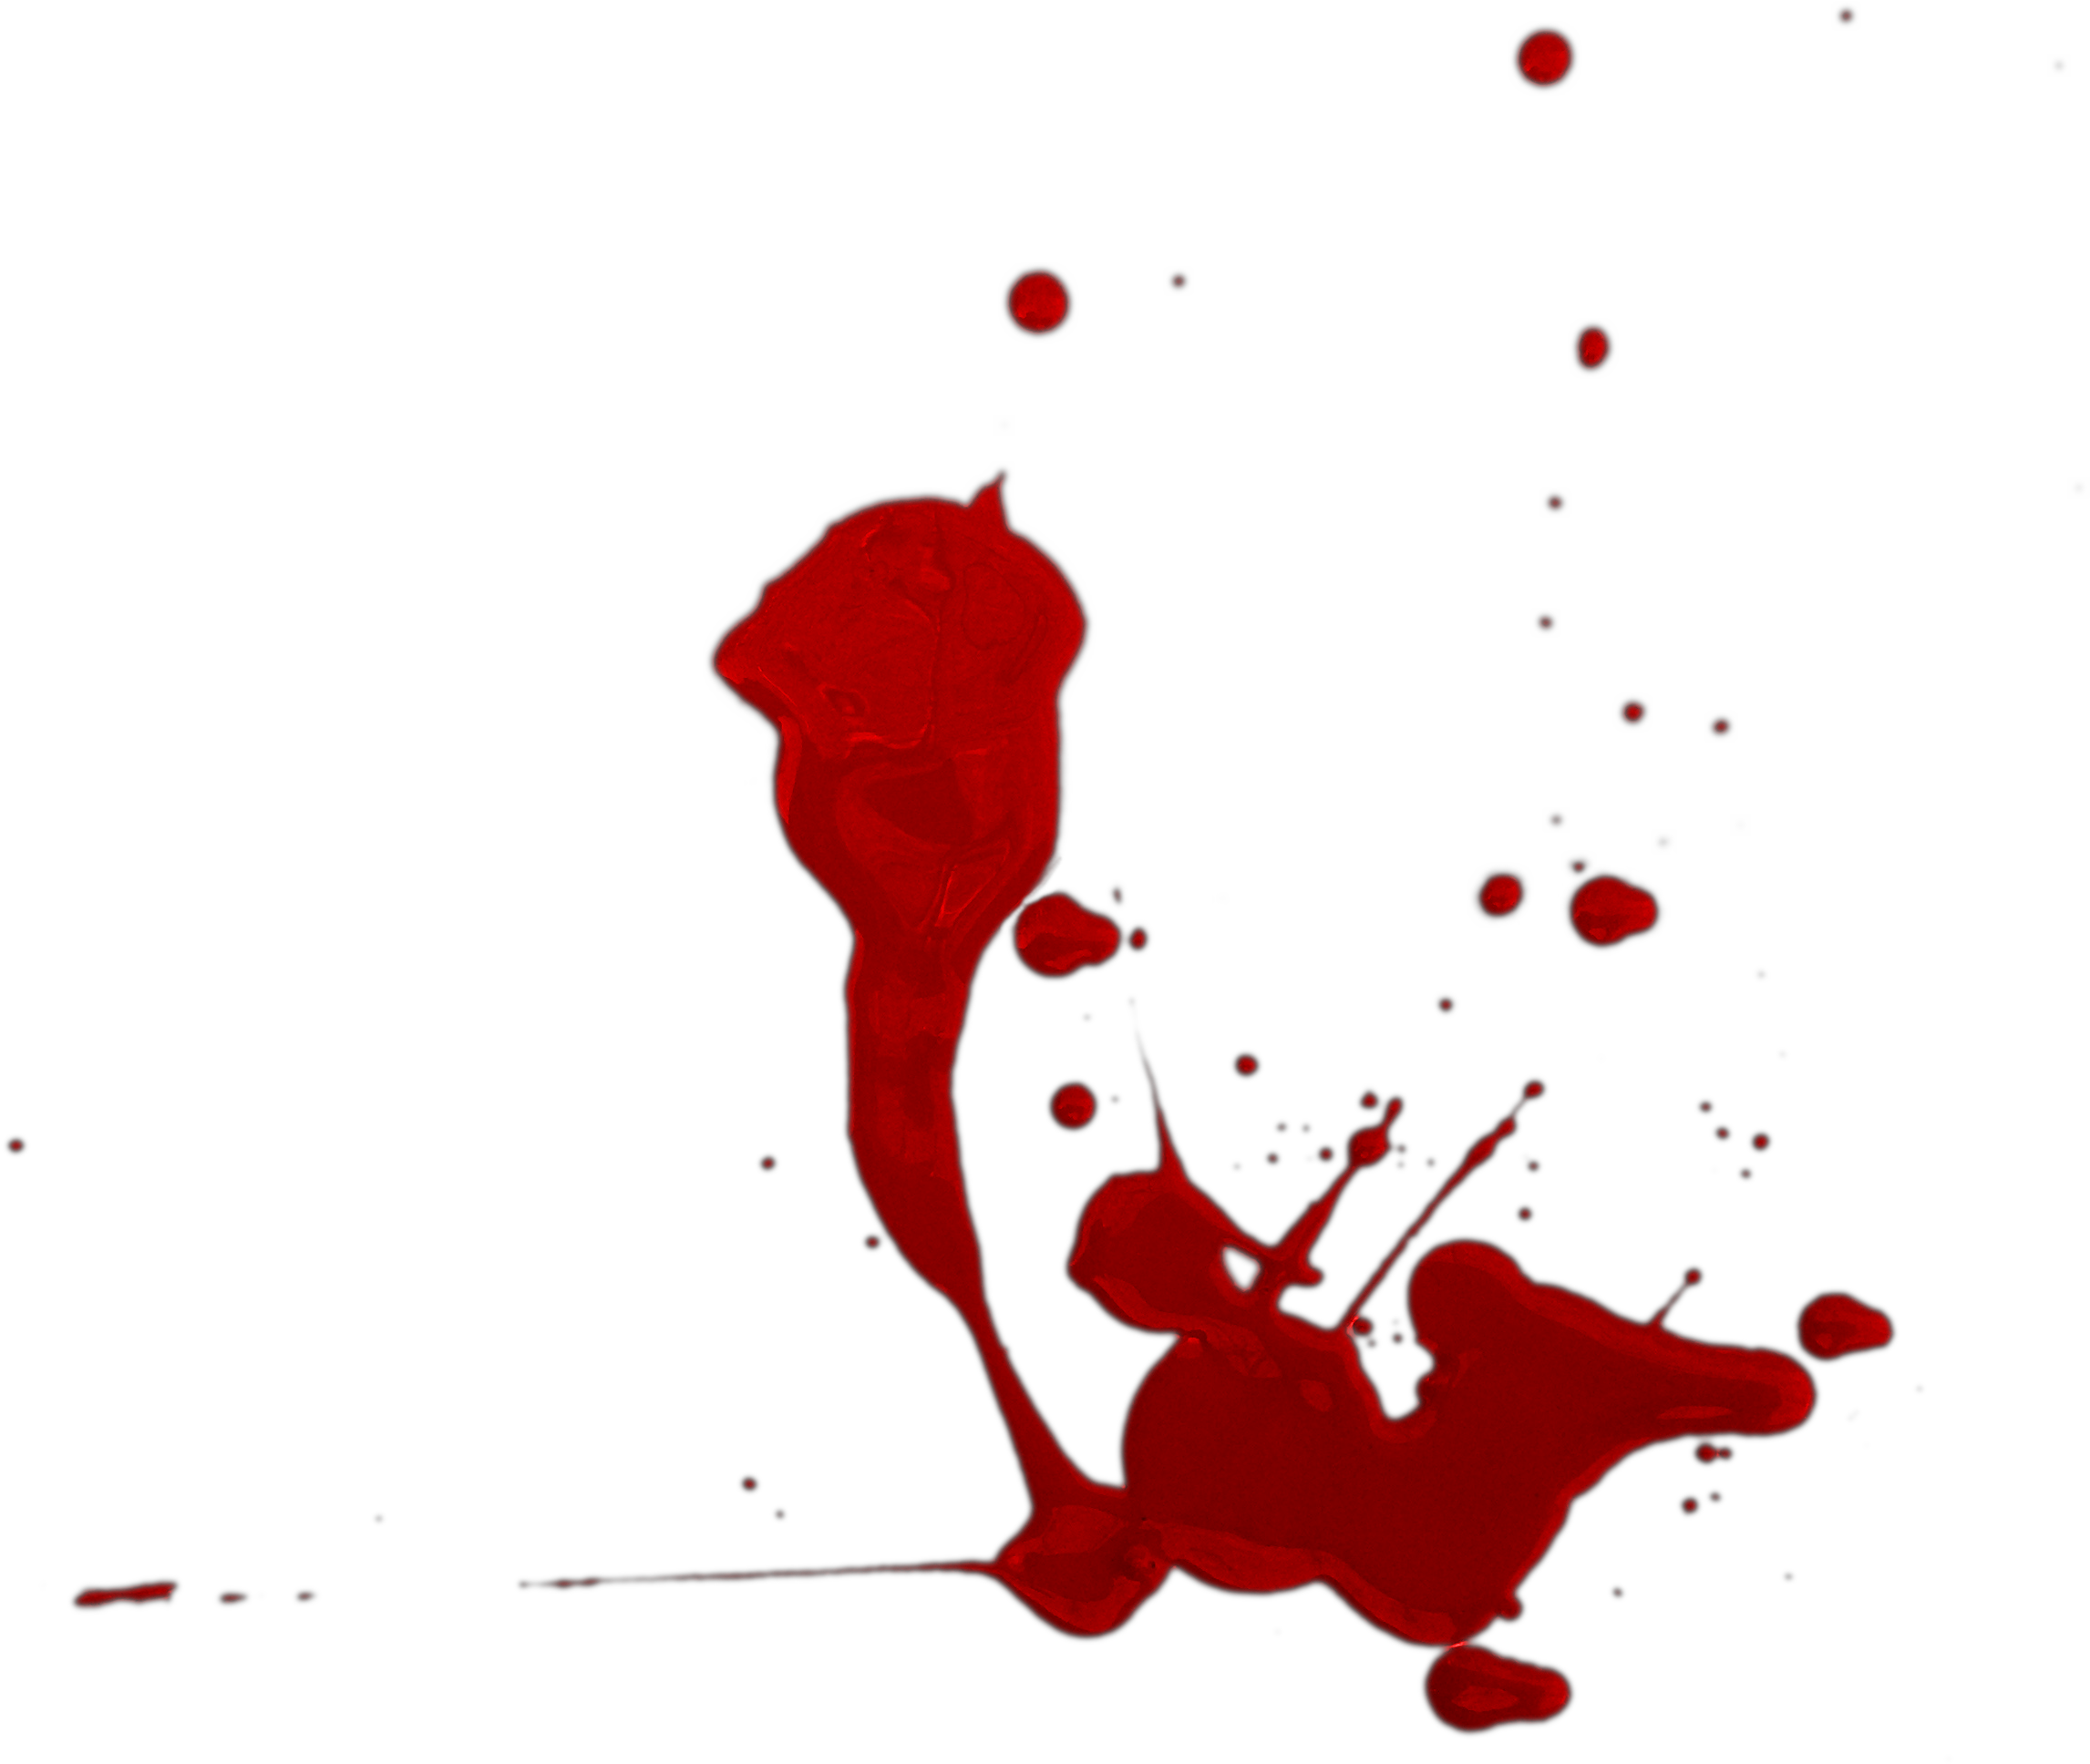
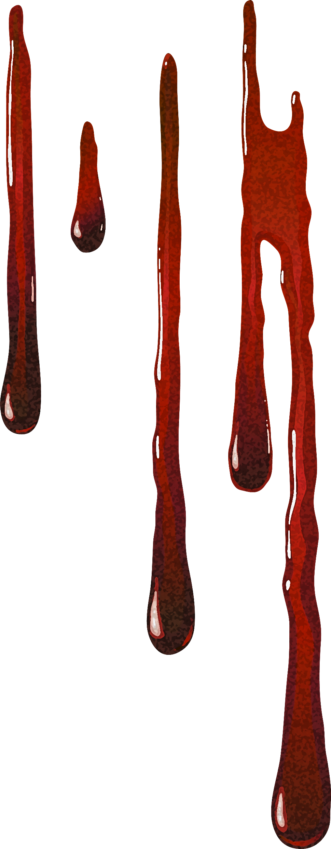
Irish potato famine brings Halloween to America
(1850)
'Boris' Pickett's Monster Mash is released
(1962)
Camille Saint-Saëns writes 'Danse Macabre’
(1874)
Bram Stoker writes Dracula
(1897)
Halloween brings $9 billion annually
(PRESENT DAY)
The church declares November 2nd 'All Souls Day’
(1000 AD)
1st Trick-or-treat in North America
(1911)
Pope Boniface IV sets 'All Martyrs Day' on May 10
(609 AD)
Mary Shelley writes 'Frankenstein’
(1818)
First 'Halloween' movie
(1978)
Sexy Halloween costumes become mainstream
(2000s)
Pope Gregory IV merges Halloween and All Saints Day
(837 AD)
Irish legend of Stingy Jack
(1800s)
The Texas Halloween Poisoning
(1980)
2020
2021
2022
2023
Apr
Aug
Dec
Apr
Aug
Dec
Apr
Aug
Dec
Apr
Celts wear masks to ward off spirits
(800-450 BC)
Aztecs celebrate 'Día de Los Muertos’
(1300-1500)
Samhain Celebrations
(50 BC - 50 AD)
Salem Witch Trials
(1692-1693)
Candy becomes 'the treat' of choice
(1950-1970)
Romans merge Samhain and Feralia
(43-84 AD)
Mass production of Halloween costumes
(1900-1920)
Pope Gregory III renames the 'All Saints Day' and moves it to November 1st
(731-741 AD)
History of Halloween timeline
Ghosts depicted wearing bed sheets
(1750-1850)

