Slide 1
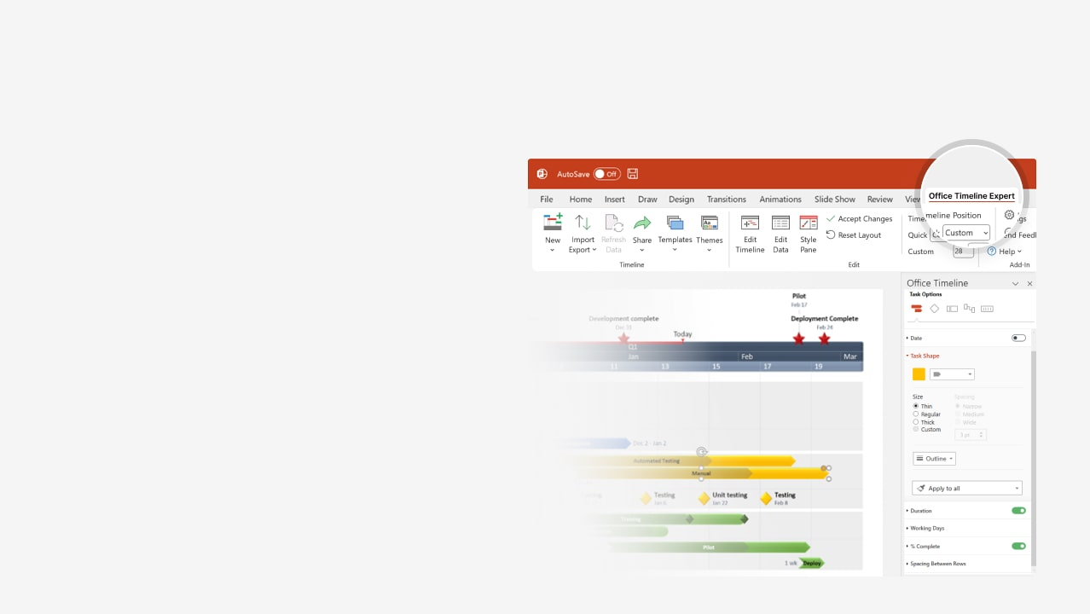

How to update this template in seconds
The Office Timeline add-in for PowerPoint will help you edit it with just a few clicks.
Get your free 14-day trial of Office Timeline here:
https://www.officetimeline.com/office-timeline/14-days-trial
Re-open this template, and create your impressive
PowerPoint visual in 3 easy steps:
1
Click the Edit Data button on the Office Timeline tab.
2
Use the Data and Timeline views to edit swimlanes, milestones and tasks.
3
Click Save to instantly update the template.

Slide 2

IT Migration Swimlane Chart Template
June
July
August
September
October
Key
Milestones
Impact Analysis
Migration Plan
Identify Stakeholders
Planning Deep Dives
Workshop Invites
Workshop Invites
Workshop Invites
Workshops
Small Migrations Workshops
Digital Migration Workshops
Asset Migration Workshops
Small Migrations
Communication
Reminder
Notification
Migration
Go Live!
Digital Migration
Communications
Reminder
Notification
Migration
Go Live!
Asset
Migration
Communications
Reminder
Notification
Migration
Go Live!

