Slide 1
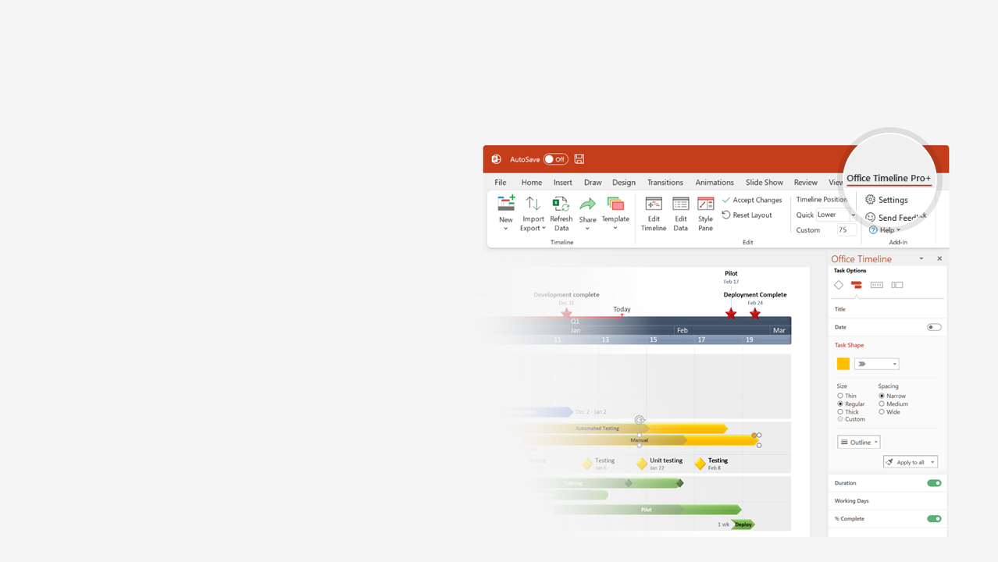

How to update this template in seconds
The Office Timeline add-in for PowerPoint will help you edit it with just a few clicks.
Get your free 14-day trial of Office Timeline here: https://www.officetimeline.com/office-timeline/14-days-trial Re-open this template, and create your impressive PowerPoint visual in 3 easy steps:
1
Click the Edit Data button on the Office Timeline tab.
2
Use the Data and Timeline views to edit swimlanes, milestones and tasks.
3
Click Save to instantly update the template.

Slide 2
Migration Plan
Migration Plan
Notification
Notification
Aug 20 - Sep 23
Jul 29 - Aug 30
Sep 21 - Oct 11
Aug 21 - Sep 18
Jun 3 - Jul 15
Jun 3 - Jun 24
Jun 30 - Aug 1
Oct 1 - Oct 15
Sep 18
Awareness
15.8 days
23.2 days
23.9 days
20.9 days
10.6 days
15 days
31 days
24 days
Blank
Blank
Blank
Blank
Blank
Blank
Blank
Jul 17
Sep 13
Jul 31
Jun 26
Jul 31
Jun 30
Jul 26
Aug 26
Jul 19
Aug 13
Jul 17
Jul 21
Aug 11
Aug 15
Sep 25
Aug 18
Oct 13
Sep 20
Oct 17
Sep 28
2025
Aug 4
Aug 8
Aug 4
Aug 8
Sep 7
Sep 5
Sep 9
Aug 2
Sep 1
M5
2025
IT roadmap template
Today
June
July
August
September
October
Key
Milestones
Impact Analysis
Migration Plan
Identify Stakeholders
Planning Deep Dives
Workshop Invites
Workshop Invites
Workshop Invites
Workshops
Small Migrations Workshops
Digital Migration Workshops
Asset Migration Workshops
Small Migrations
Communication
Reminder
Notification
Migration
Go Live!
Communications
Reminder
Digital Migration
Go Live!
Migration
Notification
Asset Migration
Communications
Reminder
Notification
Migration
Go Live!

