Slide 1
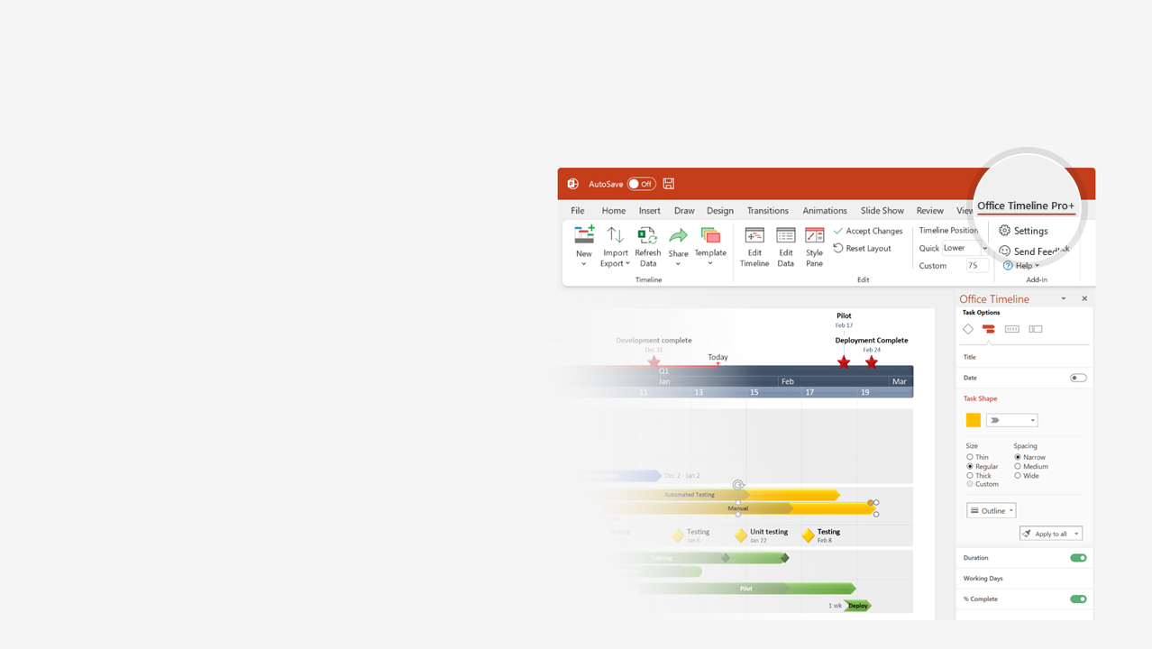

How to update this template in seconds
The Office Timeline add-in for PowerPoint will help you edit it with just a few clicks.
Get your free 14-day trial of Office Timeline here: https://www.officetimeline.com/office-timeline/14-days-trial Re-open this template, and create your impressive PowerPoint visual in 3 easy steps:
1
Click the Edit Data button on the Office Timeline tab.
2
Use the Data and Timeline views to edit swimlanes, milestones and tasks.
3
Click Save to instantly update the template.

Slide 2

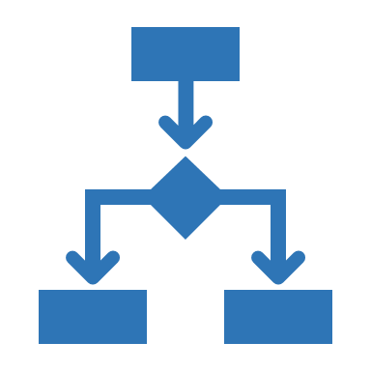


KPI Scorecard Template
Milestone
Initiative
Milestone
Milestone
Apr 2 - Apr 28
Apr 2 - Jun 2
Jun 5 - Aug 5
31.5 days
43.5 days
46.5 days
18.5 days
49.5 days
43.5 days
49.5 days
26 days
62 days
Aug 10
May 19
Oct 19
Dec 20
2021
Apr 1
Today
2021
COMPANY NAME
ADDRESS
CITY
STATE
ZIP
Objectives | Target | Current | Status
Increase Profitability | +0.6% | -0.5% | ❑
Reduce Operating Costs | +60k | -35 | ❑
Minimize Debt | 500k red | 400k red | ❐
Efficient Billings | 5 days | 4 days | ◆
Objectives | Target | Current | Status
Paperless Office Efforts | 80% | 90% | ❐
Centralize IT | 88% | 80% | ❑
Fill Empty FTEs | 0 empty | 19 empty | ❑
Employee Retention | 90% | 92% | ❐
Financial
Internal Processes
Objectives | Target | Current | Status
High Cast | 5.4/3 | 5.5/3 | ❑
Retain Customers | 450 | 448 | ◆
Fulfil Customer Needs | 5/10 | 4.5/10 | ◆
Loyalty Program | 28% | 35% | ❐
Objectives | Target | Current | Status
Open New Regions | 5 new | 2 new | ❑
Reduce Legacy Costs | -20k | -30k | ❑
Recruit Partners | 15 new | 19 new | ❐
Innovative Products | 5 new | 1 new | ❑
70%
Customer
Learning & Growth
12.5 weeks
Jan 2 - Mar 31
Q1 Review
2021/Mar
Q2 Review
2021/Jul
Q3 Review
2021/Sep
11.5 weeks
Q4 Review
2021/Dec
Jan 16
Feb 23 - Apr 7
Jun 4 - Jul 11
Jul 13 - Sep 30
Q1
Feb 2 - Apr 7
Q2
Q3
Q4
Mar 31
May 7 - Jul 15
Milestone
Mar 31
Goal 1
Initative
Apr 2 - Jun 10
Aug 5 - Oct 30
Jun 7
Jul 28
Activity
Initiative
Initative
Initiative
Activity
Activity
Initiative
Goal 2
Initiative
Initiative
Initiative
Goal 3
Activity
Activity
Activity
Activity
Activity

