Slide 1
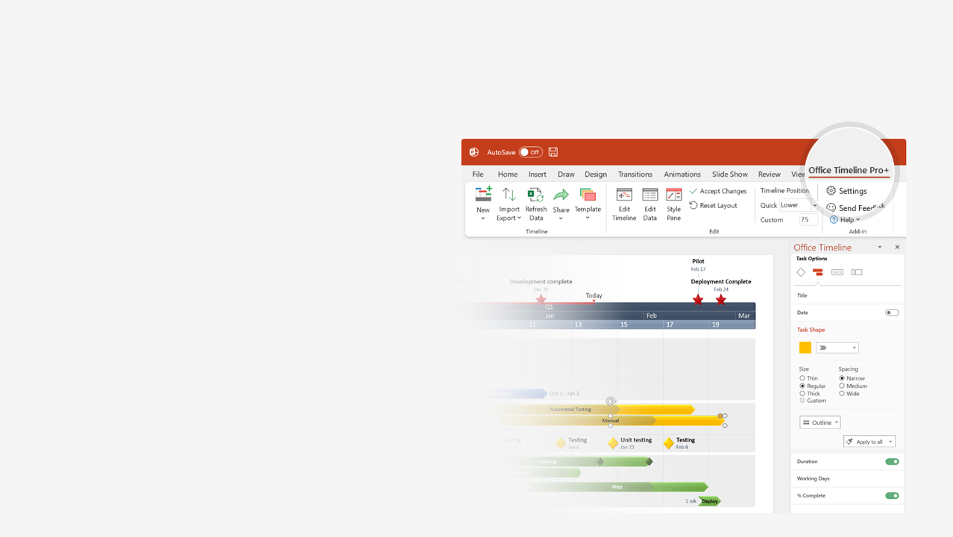
How to update this template in seconds
The Office Timeline add-in for PowerPoint will help you edit it with just a few clicks.
Get your free 14-day trial of Office Timeline here: https://www.officetimeline.com/14-days-trial Re-open this template, and create your impressive PowerPoint visual in 3 easy steps:
1
Click the Edit Data button on the Office Timeline tab.
2
Use the Data and Timeline views to edit swimlanes, milestones and tasks.
3
Click Save to instantly update the template.

Slide 2
Lego history timeline
First Lego windows and doors
Kjeld Kirk Kristiansen CEO
Lego releases Mindstorms
Ole Kirk Christiansen buys small woodworking shop
1954
1979
1998
The Lego wheel is invented
LEGO Technic Control
The Lego brick is
"Toy of the Century"
LEGO Dots, LEGO Braille
1916
1961
1986
2020
First Automatic Binding Bricks
2000
1949
The Legoland park opens
5000 employees
Lego Lord of the Rings
Company name changed to LEGO
1968
1985
2012
LEGO's 90th birthday
1934
Lego Technic is launched
Aug 10, 2022
1977
1916
1925
1934
1943
1952
1961
1970
1979
1988
1997
2006
2015
1932
1978
1992
2014
Starts manufacturing toys
Introduces
the minifigure
The world's largest
Lego Castle is built
The Lego Movie
2019
1947
1969
2005
Lego Movie 2
Company begins manufacturing plastic toys
The Duplo system
Sells Legoland parks to
Merlin Entertainments Group
1966
1999
2017
First Lego train system
Lego Star Wars
Niels B. Christiansen CEO
Jan 28, 1958
Lego patents the brick design we know today

