Slide 1
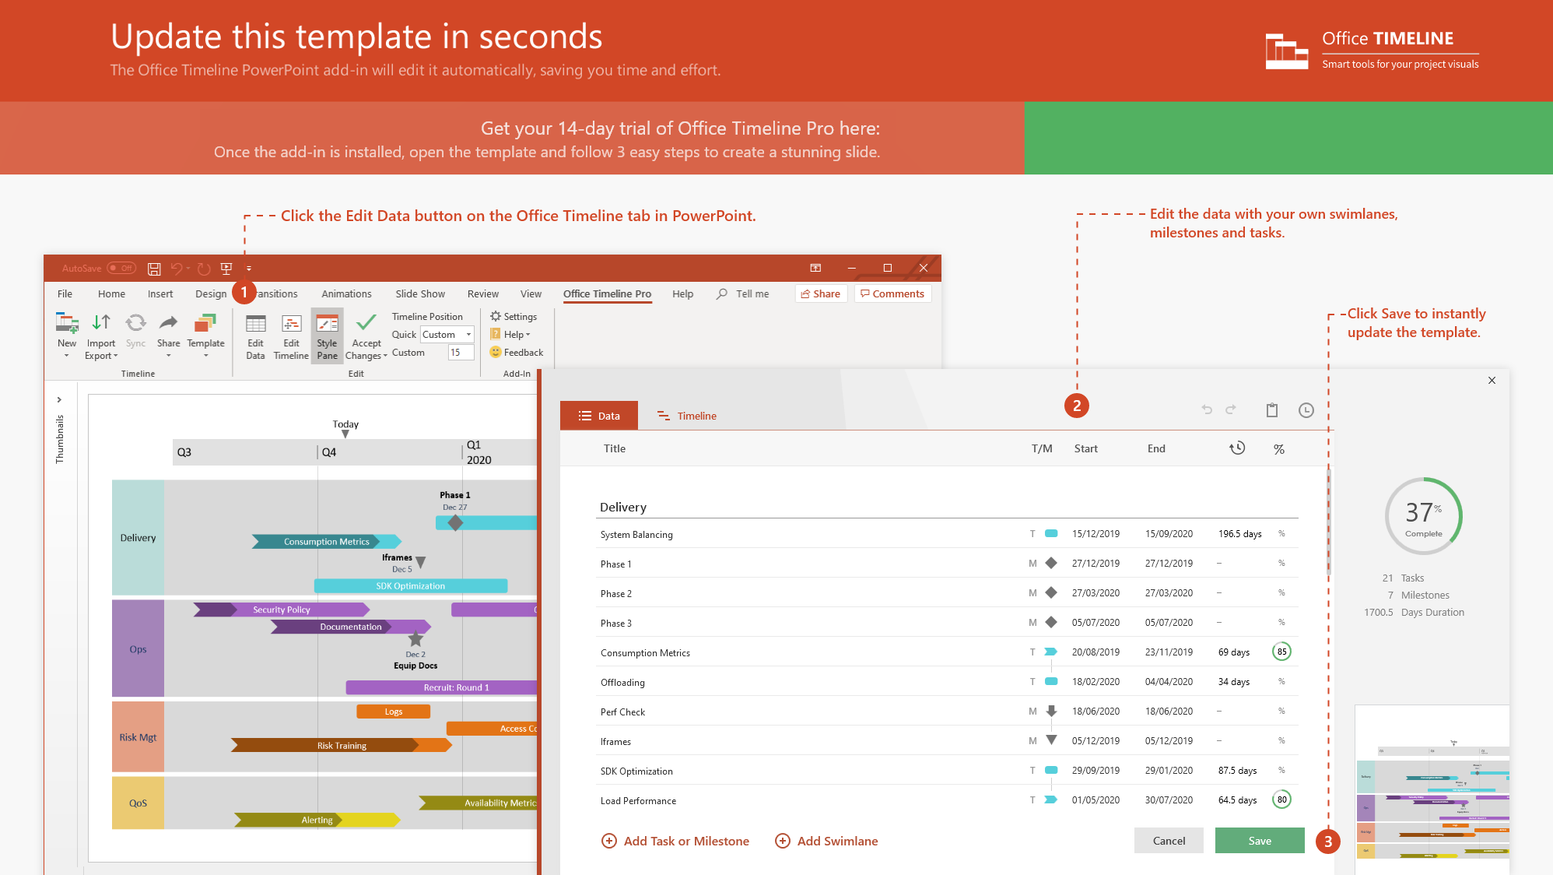
https://www.officetimeline.com/14-days-trial

Slide 2
The Phantom Menace (32 BBY)
The Force Awakens (34 ABY)
The Mandalorian (9 ABY)
Revenge of the Sith (19 BBY)
Return of the Jedi (4 ABY)
The Rise of Skywalker (35 ABY)
40 BBY
30 BBY
20 BBY
10 BBY
0 BBY
10 ABY
20 ABY
30 ABY
40 ABY
2010
2019
2028
2037
2046
2055
2064
2073
2082
The Empire Strikes Back (3 ABY)
The Last Jedi (34 ABY)
Attack of the Clones (22 BBY)
A New Hope (0 BBY)
The Clone Wars (22 BBY to 19 BBY)
Solo: A Star Wars Story (13 BBY to 10 BBY)
Planet: Nevarro
Region: Outer Rim Territories
Class: Terrestrial
Atmosphere: Breathable
Primary Terrain: Volcanic
Star Wars Rebels (5 BBY to 1 BBY)
LEGEND
BBY – Before Battle of Yavin
ABY – After Battle of Yavin

Slide 3
Battle of Yavin 0 BBY
Mandalorian Civil War 30 BBY
Din Djarin meets Grogu 9 ABY
Siege of Mandalore / Night of a Thousand Tears 19 BBY
Sabine Wren gives the Darksaber to Bo-Katan Kryze 1 BBY
Death Watch splits with Separatists 20 BBY
2020
30 BBY
20 BBY
10 BBY
0 BBY
10 ABY
20 ABY
2027
2034
2041
2048
2055
2062
2069
2076
Din Djarin rescued by Death Watch 19 BBY
Battle of Jakku 5 ABY
Clone Wars begin 22 BBY
Death Watch partners with Separatists 21 BBY
Darksaber resurfaces with Moff Gideon
9 ABY
Birth of Din Djarin 27 BBY
Sabine Wren finds the Darksaber 2 BBY
Moon of Concordia exiled insurgents form Death Watch 30 BBY
Planet: Coruscant
Region: Coruscant system
Class: Terrestrial
Atmosphere: Breathable
Primary Terrain: Urban cityscape
Bo-Katan’s Nite Owls splits with Death Watch 19 BBY
Mandalorian Survivors Form Enclave on Nevarro 0 ABY - 9 ABY
The Great Purge 0 ABY - 5 ABY

