Slide 1
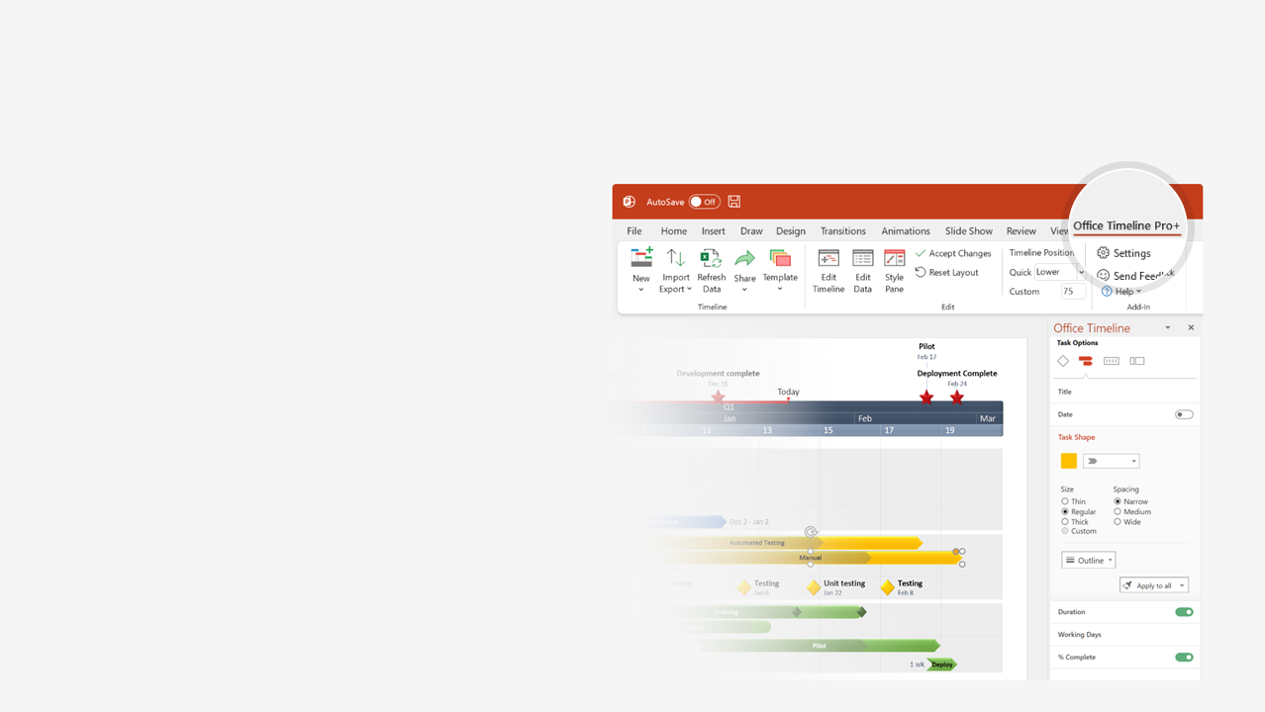
How to update this template in seconds
The Office Timeline add-in for PowerPoint will help you edit it with just a few clicks.
Get your free 14-day trial of Office Timeline here: https://www.officetimeline.com/14-days-trial Re-open this template, and create your impressive PowerPoint visual in 3 easy steps:
1
Click the Edit Data button on the Office Timeline tab.
2
Use the Data and Timeline views to edit swimlanes, milestones and tasks.
3
Click Save to instantly update the template.

Slide 2
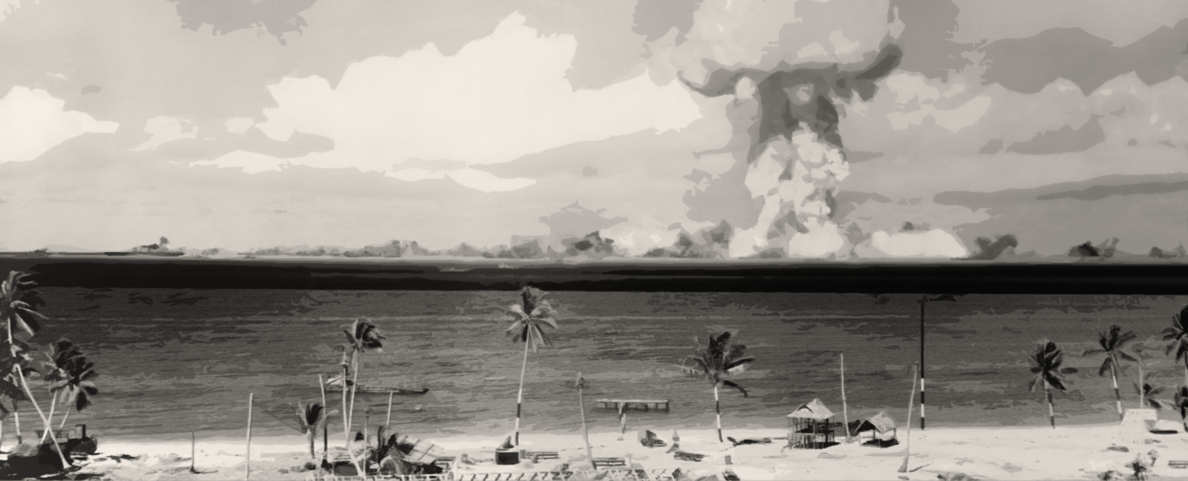
MANHATTAN
PROJECT
TIMELINE
1942 - 1947
The Manhattan Project
Manhattan Project
starts
Manhattan Project ends
WWII begins
WWII ends
Sep 1, 1939
Jun 18, 1942
Sep 2, 1945
Aug 25, 1947
1939
1940
1941
1942
1943
1944
1945
1946
1947
Japan’s attack at Pearl Harbor
D Day
Germany surrenders
Dec 7, 1941
Jun 6, 1944
May 7, 1945
US declares war on Japan, Germany and Italy
Potsdam Declaration
WWII events
Dec 9, 1941
Jul 26, 1945
Hiroshima bombing
Nagasaki bombing
Aug 6, 1945
Aug 9, 1945
Japan surrenders
Aug 14, 1945
Roosevelt approves atomic bomb creation
Los Alamos becomes the atomic bomb site
Jan 19, 1942
Nov 25, 1942
Manhattan Project
Oppenheimer: director of the project
Trinity atomic test
Oppenheimer resigns
Jul 20, 1943
Jul 16, 1945
Oct 1, 1945
Truman signs the Atomic Energy Act
Aug 1, 1946

