Slide 1
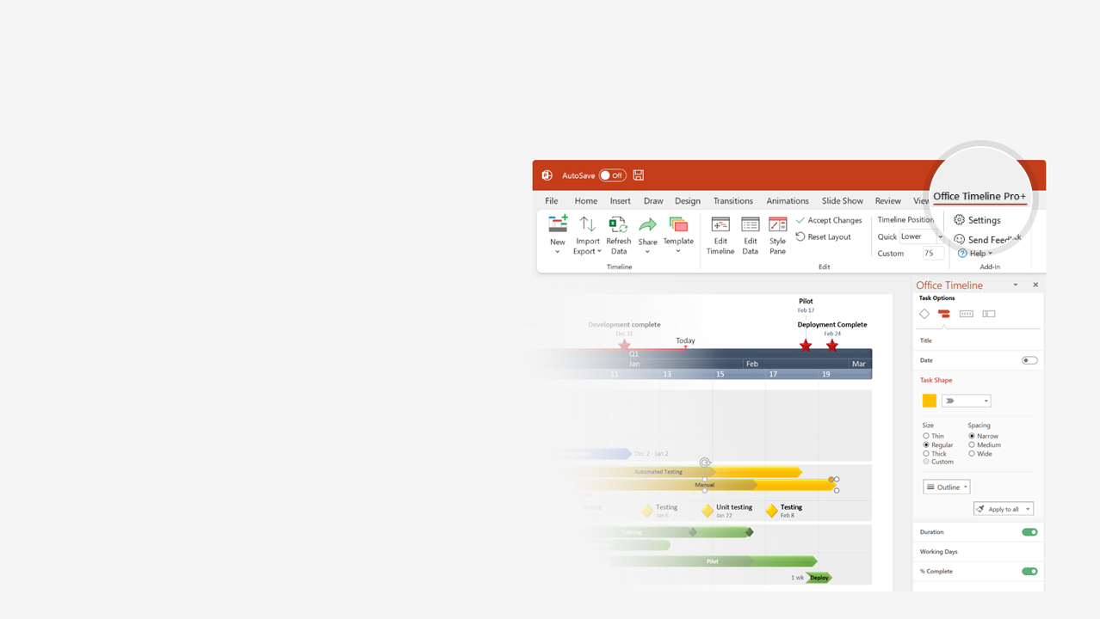

How to update this template in seconds
The Office Timeline add-in for PowerPoint will help you edit it with just a few clicks.
Get your free 14-day trial of Office Timeline here:
https://www.officetimeline.com/14-days-trial
Re-open this template, and create your impressive
PowerPoint visual in 3 easy steps:
1
Click the Edit Data button on the Office Timeline tab.
2
Use the Data and Timeline views to edit swimlanes, milestones and tasks.
3
Click Save to instantly update the template.

Slide 2
Milestone Tracker
Kick Off
May 10
Milestone 1
Milestone 2
Milestone 3
Milestone 4
Milestone 5
Milestone 6
Milestone 7
Sign Off
Jun 16
Jul 21
Sep 20
Oct 30
Jan 30
Mar 1
Mar 30
May 30
Q2
Q3
Q4
Q1
Q2
May
Jul
Sep
Nov
Jan
Mar
May
Aug 1
Dec 22
May 20
Checkpoint A
Checkpoint B
Checkpoint C
Phase 1
Phase 2
Phase 3

