Slide 1
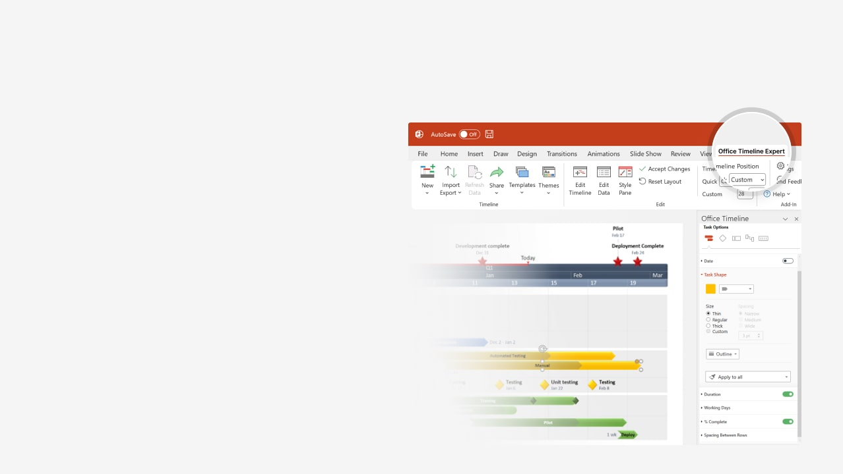

How to update this template in seconds
The Office Timeline add-in for PowerPoint will help you edit it with just a few clicks.
Get your free 14-day trial of Office Timeline here: https://www.officetimeline.com/office-timeline/14-days-trial Re-open this template, and create your impressive PowerPoint visual in 3 easy steps:
1
Click the Edit Data button on the Office Timeline tab.
2
Use the Data and Timeline views to edit swimlanes, milestones and tasks.
3
Click Save to instantly update the template.

Slide 2

One Page Business Plan
May 12 - Jul 20
Complete Market Analysis
May 12 - May 30
Segmentations
Jun 11 - Jul 20
Industry Analysis
Jun 4 - Jul 2
Compete
May 20 - Jun 15
Pricing and Economics
Jun 26 - Aug 20
Create Go-to-Market Strategy
Jul 4 - Jul 22
Marketing Plan
Jul 18 - Jul 30
Sales Forecast
Jun 26 - Aug 20
Website
2025
May
Jun
Jul
Aug
May 1 - Aug 31
Business Plan
Mission
Define Objectives
Success
Ownership
Investment Summary
Define Service

