Slide 1
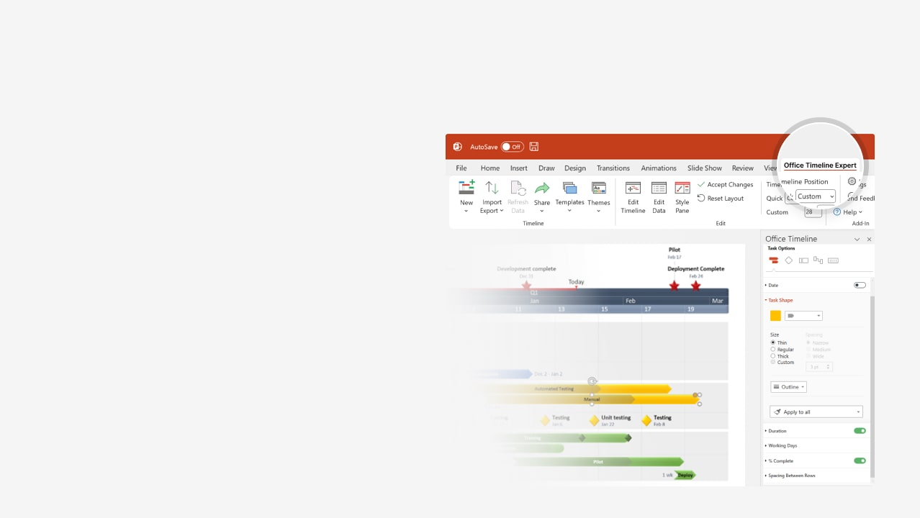

How to update this template in seconds
The Office Timeline add-in for PowerPoint will help you edit it with just a few clicks.
Get your free 14-day trial of Office Timeline here: https://www.officetimeline.com/office-timeline/14-days-trial Re-open this template, and create your impressive PowerPoint visual in 3 easy steps:
1
Click the Edit Data button on the Office Timeline tab.
2
Use the Data and Timeline views to edit swimlanes, milestones and tasks.
3
Click Save to instantly update the template.

Slide 2

Pert chart
2024
2025
Jun
Aug
Oct
Dec
Feb
Apr
Jun
6/18/2024
Today
9/24/2024
12/20/2024
4/1/2025
7/31/2025
Kick-Off
Validation
Minimal Prototype
Integrated Prototype
5/21/2025
Submission
Integration
Requirements
27 days
6/25 - 7/21
Validation
35 days
7/5 - 8/8
Data Analysis
39 days
7/25 - 9/1
Architectural Review
System Design
Database
38 days
9/7 - 10/14
Data Improve
26 days
9/25 - 10/20
Coding
63 days
10/15 - 12/16
Website Testing
Online Testing
Coding
85 days
1/15 - 4/9
System Testing
37 days
3/25 - 4/30
Stabilization
57 days
4/1 - 5/27
Performance Enhancing
Integration with Website
User Acceptance Testing
20 days
6/14 - 7/3
Documentation
24 days
7/2 - 7/25
Stage 1 Submission
21 days
7/10 - 7/30

