Slide 1
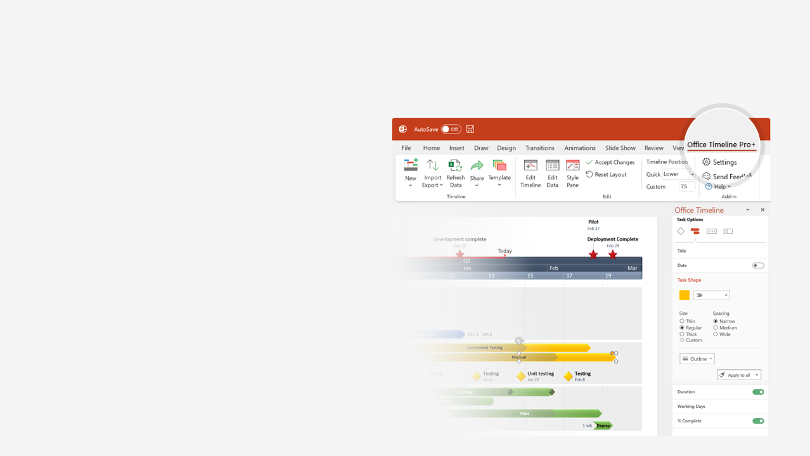
How to update this template in seconds
The Office Timeline add-in for PowerPoint will help you edit it with just a few clicks.
Get your free 14-day trial of Office Timeline here: https://www.officetimeline.com/14-days-trial Re-open this template, and create your impressive PowerPoint visual in 3 easy steps:
1
Click the Edit Data button on the Office Timeline tab.
2
Use the Data and Timeline views to edit swimlanes, milestones and tasks.
3
Click Save to instantly update the template.

Slide 2
2025
2029
Today
Clinical Trial Gantt chart
Apply for Drug Approval
Estimated Drug Approval Date
Report
Report
Oct 15 '25
Aug 10 '27
May 18 '28
Nov 11 '28
2025
2026
2027
2028
2029
Jan
Jun
Nov
Apr
Sep
Feb
Jul
Dec
May
Oct
Stages
Recruitment
Enrollment
Kick-off
Modifications
Patients Recruited
Patients
Enrolled
Study Kick-off
Phase I
Feb 4 '25
Jun 3 '25
Sep 9 '25
Trial
18 mons
Jan 2025 - Jun 2026
Patients
Recruited
Patients
Enrolled
Study
Kick-off
Study
Modified
Phase II
Aug 7 '26
Dec 11 '26
May 8 '27
Sep 17 '27
Trial
19 mons
Jul 2026 - Jan 2028
Patients
Recruited
Patients
Enrolled
Study
Kick-off
Phase III
Oct 11 '27
Feb 10 '28
May 15 '28
Made with
Trial
14 mons
Sep 2027 - Nov 2028

Slide 3
Jan 2066 - Apr 2069
2023 - 2027
2027 - 2033
2033 - 2050
2050 - 2066
12.5 years
4.5 years
5.5 years
5.5 years
11 years
6 years
0%
0%
0%
0%
0%
0%
0%
0%
0%
0%
0%
2023
2070
Pharmaceutical Product Discovery
Timeline for drug discovery
Drug Selection
IND Submission
NDA Submission
Approval
Feb 2024
Jul 2027
Dec 2032
Jan 2067
2023
2027
2031
2035
2039
2043
2047
2051
2055
2059
2063
2067
Today
Availability
Lifecycle
Discovery
Pre-clinical
Clinical Trials
Licensing Approval
4.5 years
5.5 years
17.5 years
15.5 years
3.3 years
10K Candidates
2023 - 2027
20 Candidates
2027 - 2033
10 Candidates
2033 - 2038
Selection
2-5 Candidates
2039 - 2044
1-2 Drug Candidates
2044 - 2055
1 Drug
2055 - 2068
Made with
Reviews
Phase 1 Review
Phase 2 Review
Phase 3 Review
Apr 2033
Nov 2044
Jan 2056

Slide 4
Jan 20 - Dec 9
Mar 1 - Jan 15
Apr 1 - Dec 2
Apr 1 - Mar 1
232 days
229 days
176 days
239 days
2025
2026
Today
International Pharma product launch timeline
2025
2026
Jan
Mar
May
Jul
Sep
Nov
Jan
Mar
United States
China
Japan
Germany
United Kingdom
India
Product Alpha
Jan 20
Apr 28
Jul 4
Aug 15
Sep 28
Dec 8
Timeline
United States
China
Japan
Germany
India
United Kingdom
Product Beta
Mar 1
May 14
Jul 1
Aug 12
Dec 5
Jan 15
Timeline
United States
China
Japan
Germany
United Kingdom
India
Product Gamma
Apr 1
May 18
Jul 5
Sep 4
Oct 13
Nov 30
Timeline
United States
China
Japan
Germany
United Kingdom
India
Made with
Product Delta
Apr 1
Jun 22
Aug 17
Nov 3
Dec 30
Mar 1
Timeline

