Slide 1
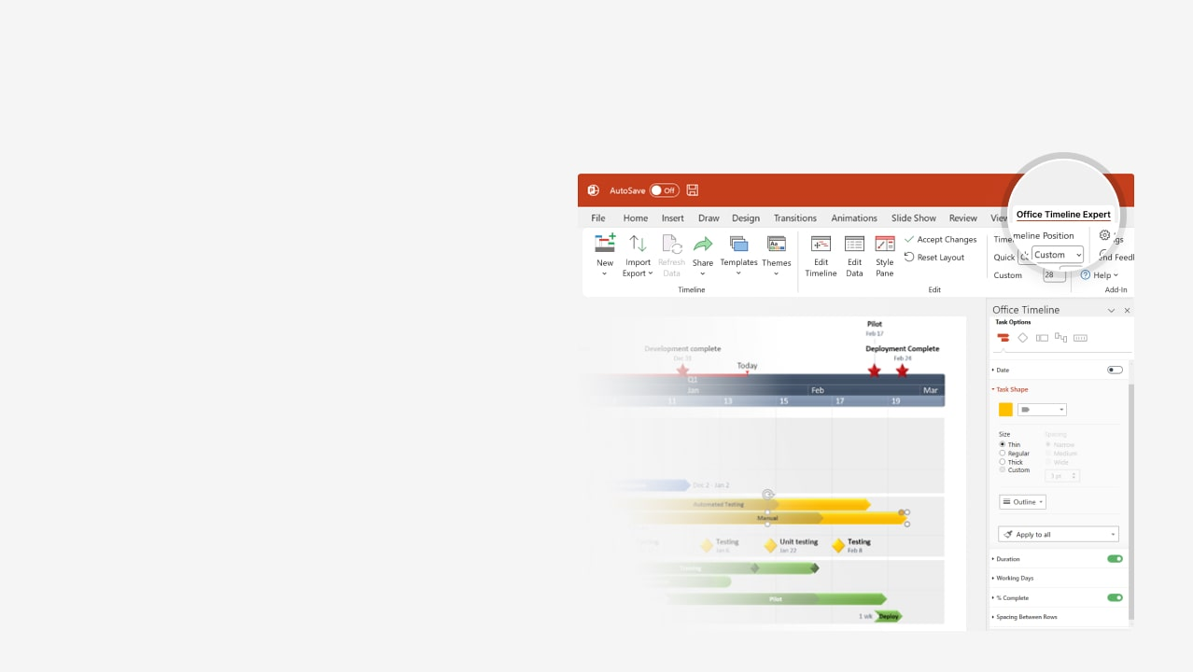
How to update this template in seconds
The Office Timeline add-in for PowerPoint will help you edit it with just a few clicks.
Get your free 14-day trial of Office Timeline here: https://www.officetimeline.com/office-timeline/14-days-trial Re-open this template, and create your impressive PowerPoint visual in 3 easy steps:
1
Click the Edit Data button on the Office Timeline tab.
2
Use the Data and Timeline views to edit swimlanes, milestones and tasks.
3
Click Save to instantly update the template.

Slide 2
Pharmacokinetics and pharmacodynamics timeline
7 am
8 am
9 am
10 am
11 am
12 pm
1 pm
Metabolism
Elimination
Pharmacokinetics
Drug administration
Absorption
Distribution
Molecular targets for drug interaction (receptors, enzymes, ion channels, transporters)
Pharmacodynamics
Transfer to site of action
Regulatory proteins
Drug binding to specific target (affinity)
Mechanism of drug action
Efficacy - Response to drug

Slide 3
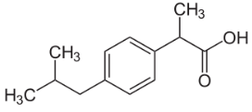
Pharmacokinetics - pharmacodynamics timeline of ibuprofen
Drug administration
(oral - 400 mg)
8 am
9 am
10 am
11 am
12 pm
1 pm
2 pm
3 pm
4 pm
5 pm
6 pm
7 pm
8 pm
9 pm
10 pm
11 pm
12 am
1 am
Cmax​ ~30μg/mL
Absorption
2 h
Absorption
Vd ~0.1 to 0.2L/kg
Distribution
Pharmacokinetics
1.9 h
Distribution
t1/2~2 to 4 hours
Metabolism
6 h
Metabolism [main]
Metabolism
2 h
Cl~400mg÷30μg/mL
Elimination
6 h
Elimination [main]
Elimination [residual - can take up to 18 hours]
Cmax​ ~30μg/mL
Site of action
Pharmacodynamics
1 h
Drug concentration at the site of action
Clinical outcomes
t1/2~2 to 4 hours
6 h
Effectiveness
[Toxicity, concentration>400 mg/kg]
C₁₃H₁₈O₂

Slide 4
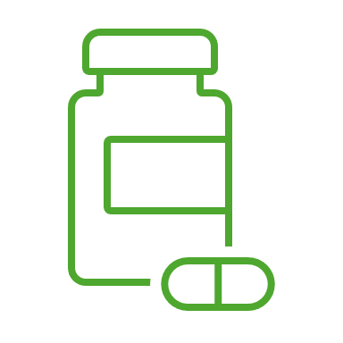
Comparative absorption pharmacokinetics of antihistamines
Time to action & Time to maximum plasma concentration (Tmax) timeline
Administration time
8 am
9 am
10 am
Chlorpheniramine
3 h
Tmax~2.8±0.8 h
Time to action
First generation
Diphenhydramine
2 h
Tmax~1.7±1.0 h
Time to action
Hydroxyzine
2 h
Tmax~2.1±0.4 h
Time to action
T
0.1 h
Acrivastine
1 h
0.3 h
Tmax~1.4±0.4 h
Time to action
T
Cetirizine
1 h
Tmax~1.0±0.5 h
Time to action
Loratadine
2 h
Tmax~1.2±0.3 h
Time to action
Decarboethoxyloratadine
2 h
Tmax~1.5±0.7 h
Time to action
Ebastine / Carebastine
2 h
0.7 h
Tmax~2.6±5.7 h
Second generation
Time to action
T
Fexofenadine
2 h
0.7 h
Tmax~2.6 h
Time to action
T
Mizolastine
1 h
0.5 h
Tmax~1.5 h
Time to action
T
Levocetirizine
1 h
Tmax~0.8±0.5 h
Time to action
Desloratadine
2 h
Tmax~2-3 h
Time to action
Rupatadine
2 h
Tmax~0.75 h
Time to action

Slide 5
Time to maximum drug concentration (Tmax)
Comparative timeline per route of administration
Tmax.
T1/2
8:05 am
9:00 am
Intravenous
6.5 h
Tmax.
T1/2
9:00 am
9:30 am
Intramuscular
6 h
Tmax.
T1/2
8:30 am
10:00 am
Sublingual (powder)
6 h
Tmax.
T1/2
10:00 am
12:00 pm
Oral tablet
6 h
Tmax.
T1/2
10:00 am
12:00 pm
Oral capsule
7 h
8 am
9 am
10 am
11 am
12 pm
1 pm
2 pm
8:00 am
Administration time t0

Slide 6
Clinical trial Gantt chart
Apply for Drug Approval
Estimated Drug Approval Date
Report
Report
Oct 15 '22
Aug 10 '24
May 18 '25
Nov 11 '25
2022
2023
2024
2025
Jan
May
Sep
Jan
May
Sep
Jan
May
Sep
Jan
May
Sep
Patients Recruited
Patients
Enrolled
Study Kick-off
Stages
Recruitment
Enrollment
Kick-off
Modifications
Phase I
Feb 4 '22
Jun 3 '22
Sep 9 '22
Trial
18 mons
Jan 2022 - Jun 2023
Patients
Recruited
Patients
Enrolled
Study
Kick-off
Study
Modified
Phase II
Aug 3 '23
Dec 7 '23
Apr 4 '24
Jul 13 '24
Trial
19 mons
Jul 2023 - Feb 2025
Patients
Recruited
Patients
Enrolled
Study
Kick-off
Phase III
Oct 7 '24
Jan 31 '25
May 8 '25
Trial
13 mons
Sep 2024 - Oct 2025

Slide 7
Comparative pharmacologic timeline of statin characteristics
Half-life (t1/2), bioavailability (F), absorption (Fa)
Administration time (t0)
8:00 am
7 am
9 am
11 am
1 pm
3 pm
5 pm
7 pm
9 pm
11 pm
1 am
3 am
5 am
7 am
9 am
11 am
1 pm
Atorvastatin (10-80 mg)
F=12% Fa=30%
15 h
15 h
t1/2 min.
t1/2 max.
Fluvastatin (20-80 mg)
F=19-29% Fa=98%
3.2 h
t1/2 max.
0.5 h
t1/2 min.
Lipophilic (dose mg)
Lovastatin (10-80 mg)
F<5% Fa=30%
2.9 h
t1/2
Pitavastatin (1-4 mg)
F=51% Fa=50%
8 h
4 h
t1/2 max.
t1/2 min.
Simvastatin (5-80 mg)
F<5% Fa=60-80%
2 h
1 h
t1/2 max.
t1/2 min.
Pravastatin (40-80 mg)
F=18% Fa=24%
1.3 h
1.5 h
t1/2 max.
Hidrophilic (dose mg)
t1/2 min.
Rosuvastatin (5-40 mg)
F=20% Fa=Rapid
15 h
15 h
t1/2 min.
t1/2 max.

