Slide 1
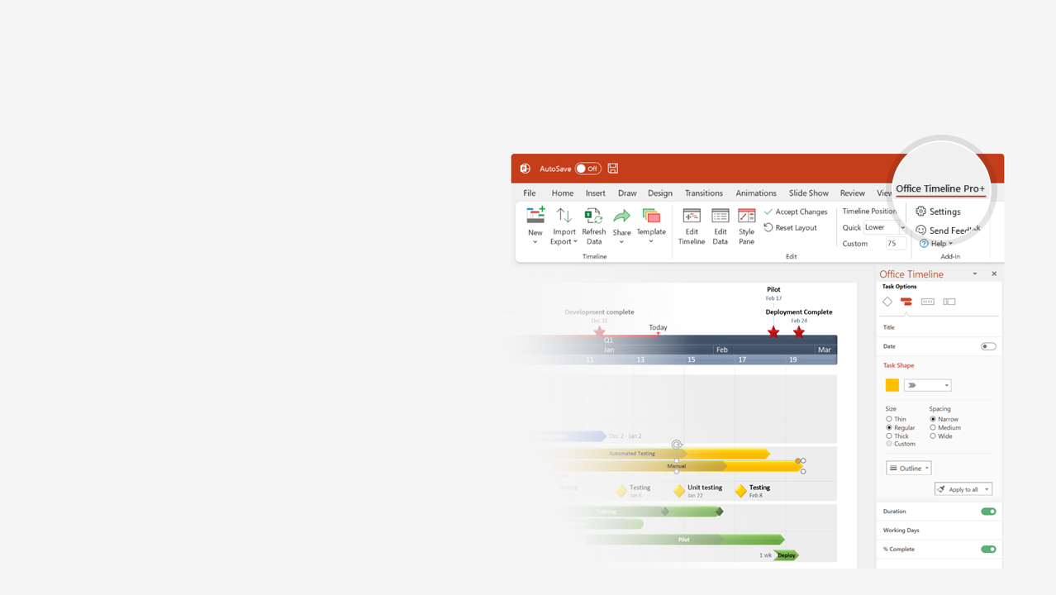

How to update this template in seconds
The Office Timeline add-in for PowerPoint will help you edit it with just a few clicks.
Get your free 14-day trial of Office Timeline here:
https://www.officetimeline.com/office-timeline/14-days-trial
Re-open this template, and create your impressive
PowerPoint visual in 3 easy steps:
1
Click the Edit Data button on the Office Timeline tab.
2
Use the Data and Timeline views to edit swimlanes, milestones and tasks.
3
Click Save to instantly update the template.

Slide 2
UCAI Platform Roadmap
Dev Stream | Owner | Target
Foundation API Coverage | Alex | 90%
Infrastructure architecture | Dan | 100%
Test coverage | Ana | 35%
Project Summary
Intelligently connect content, financial data, and business events together for real-time inventory management.
Executive Review
Mar 10, 2021
Project Kickoff
Executive Decision
Final Release
Jan 25, 2021
Mar 21, 2021
Oct 20, 2021
Jan
Feb
Mar
Apr
May
Jun
Jul
Aug
Sep
Oct
Nov
2021
Planning
Content Plan
Planning R2 Begin
Assemble Resources
Subcontractor Selection
46 days
September 30, 2021
Prototype
Alpha
Product Development
Development
65%
29 wks
Integration
Integration
Performance Validation
RTW Deployment
Press Release
Public Website Live
Marketing
Beta Blog Launch
WW Launch Event

