Slide 1
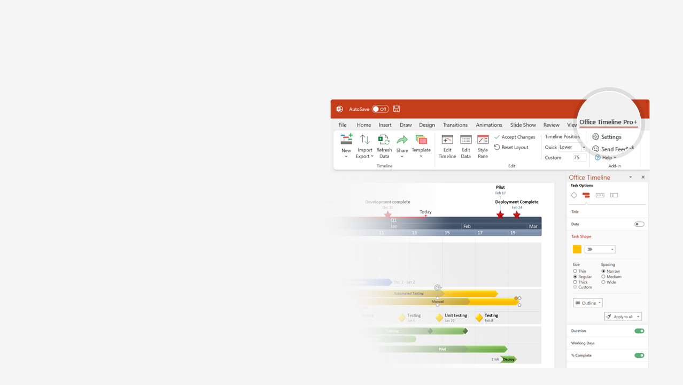

How to update this template in seconds
The Office Timeline add-in for PowerPoint will help you edit it with just a few clicks.
Get your free 14-day trial of Office Timeline here:
https://www.officetimeline.com/office-timeline/14-days-trial
Re-open this template, and create your impressive
PowerPoint visual in 3 easy steps:
1
Click the Edit Data button on the Office Timeline tab.
2
Use the Data and Timeline views to edit swimlanes, milestones and tasks.
3
Click Save to instantly update the template.

Slide 2
2021
2021
PowerPoint Timeline
Kick Off
Checkpoint A
Checkpoint B
Checkpoint C
Sign Off
Jan 10
Milestone 1
Apr 1
Milestone 4
Jul 12
Milestone 6
Oct 20
Dec 22
Feb 25
Milestone 2
Milestone 3
Jun 5
Milestone 5
Sep 10
Milestone 7
Mar 21
May 20
Aug 4
Oct 1
34 days
Today
Jan
Feb
Mar
Apr
May
Jun
Jul
Aug
Sep
Oct
Nov
Dec
29 days
Requirements
100%
Jan 13 - Mar 1
35 days
Prototype
Feb 2
100%
Mar 14
150 days
Specs
Mar 14
82%
May 2
18 days
Development
Mar 25
14%
Oct 20
25 days
Stabilize
Oct 21
0%
Nov 15
Launch
Nov 16
0%
Dec 20

