Slide 1
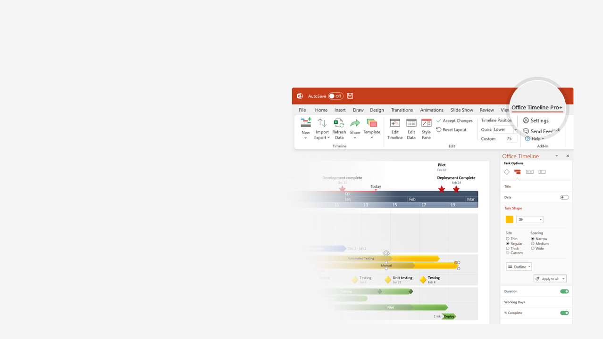

How to update this template in seconds
The Office Timeline add-in for PowerPoint will help you edit it with just a few clicks.
Get your free 14-day trial of Office Timeline here:
https://www.officetimeline.com/office-timeline/14-days-trial
Re-open this template, and create your impressive
PowerPoint visual in 3 easy steps:
1
Click the Edit Data button on the Office Timeline tab.
2
Use the Data and Timeline views to edit swimlanes, milestones and tasks.
3
Click Save to instantly update the template.

Slide 2
Executive Roadmap
Kickoff meeting
Initial assessment
Partial assessment
Final assessment
Q2
Q3
Q4
Q1
Q2
Q3
Q4
Apr
Jun
Aug
Oct
Dec
Feb
Apr
Jun
Aug
Oct
KPIs defined
Effort planning
Subcontractor selection
Planning
Planning assessment
Resource planning
Assessment meeting
Phase 1
Designing and deploying
Execution
Phase 2
Network building
Phase 3
Installing and configuring
Confirm completion
Closing
Transfer deliverables
Release resources
Archive documentation

