Slide 1
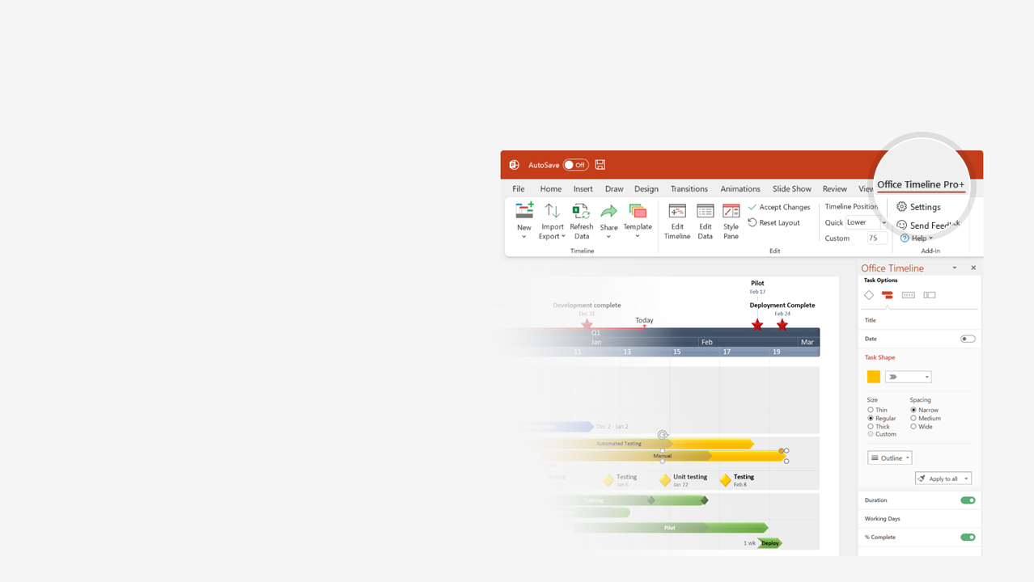

How to update this template in seconds
The Office Timeline add-in for PowerPoint will help you edit it with just a few clicks.
Get your free 14-day trial of Office Timeline here: https://www.officetimeline.com/14-days-trial Re-open this template, and create your impressive PowerPoint visual in 3 easy steps:
1
Click the Edit Data button on the Office Timeline tab.
2
Use the Data and Timeline views to edit swimlanes, milestones and tasks.
3
Click Save to instantly update the template.

Slide 2

Project Kickoff
Project roadmap
Final Release
Jan 25
Executive Decision
Oct 30
Mar 30
Executive Review
Beta Release
Release Candidate
Mar 1
Jun 29
Oct 2
Jan
Feb
Mar
Apr
May
Jun
Jul
Aug
Sep
Oct
Nov
Dec
Today
Allocate resources
Jan 2 - Feb 15
Working plans
Plan
Feb 6 - Mar 14
Subcontractor selection
Mar 6 - May 12
Helpdesk content plan
May 15 - Jul 13
Test
Integration I
Integration II
Integration III
May 10 - Jun 30
Jul 3 - Aug 15
Aug 16 - Oct 2
Prototype
Mar 1 - Mar 30
Alpha build
Apr 3 - May 15
Develop
Development phase I
Apr 3 - Nov 15
Development phase II
Aug 16 - Nov 15
V2 development start
Nov 1 - Dec 22
Launch
Ongoing marketing
Jan 2 - Dec 29

