Slide 1
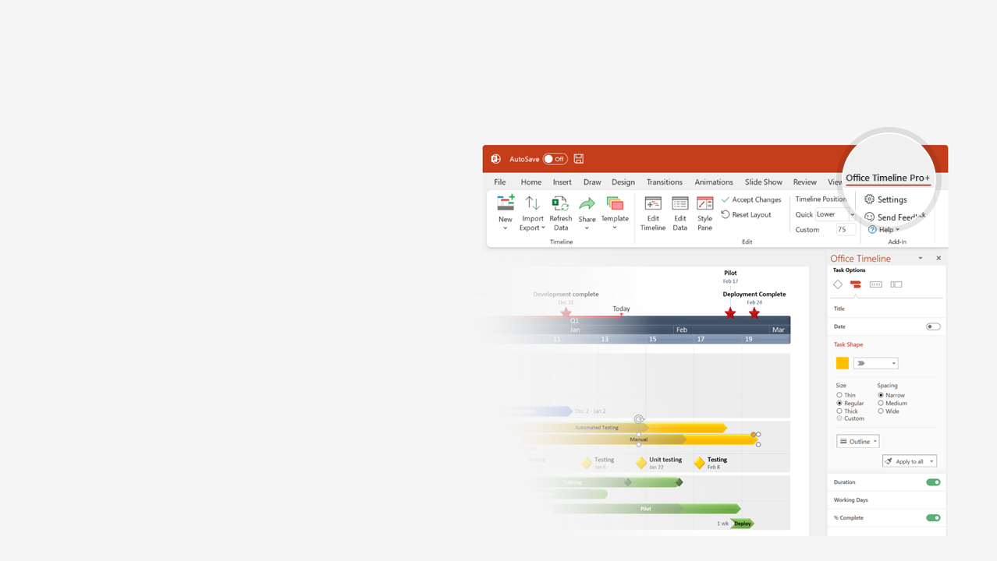

How to update this template in seconds
The Office Timeline add-in for PowerPoint will help you edit it with just a few clicks.
Get your free 14-day trial of Office Timeline here:
https://www.officetimeline.com/office-timeline/14-days-trial
Re-open this template, and create your impressive
PowerPoint visual in 3 easy steps:
1
Click the Edit Data button on the Office Timeline tab.
2
Use the Data and Timeline views to edit swimlanes, milestones and tasks.
3
Click Save to instantly update the template.

Slide 2
Strategy roadmap
Q1 Review
Q2 Review
Q3 Review
Q4 Review
Mar 31
7/5
9/27
12/20
Q1
Q2
Q3
Q4
Kickoff Meeting
Project initiation
Vision
KPIs Defined
Planning
Objectives
Preliminary assessment
Partial assessment
Goals
Strategic Intent
Sales Budget
Beta + Release Plans
Market analysis
Competitor Review
Strategy
Market Analysis
SWOT
Business analysis
Business Model
Price Research
Objectives
Sales Trends Analysis
Alpha
Beta
Staging
Launch
Service Development
Design
Development
RC
Release to Web
Business Intelligence
Service Metrics
Quality Metrics
Service Dashboard
Real-time Analytics
Sales Dashboard
Conversion Metrics
Real-time Reporting

