Slide 1
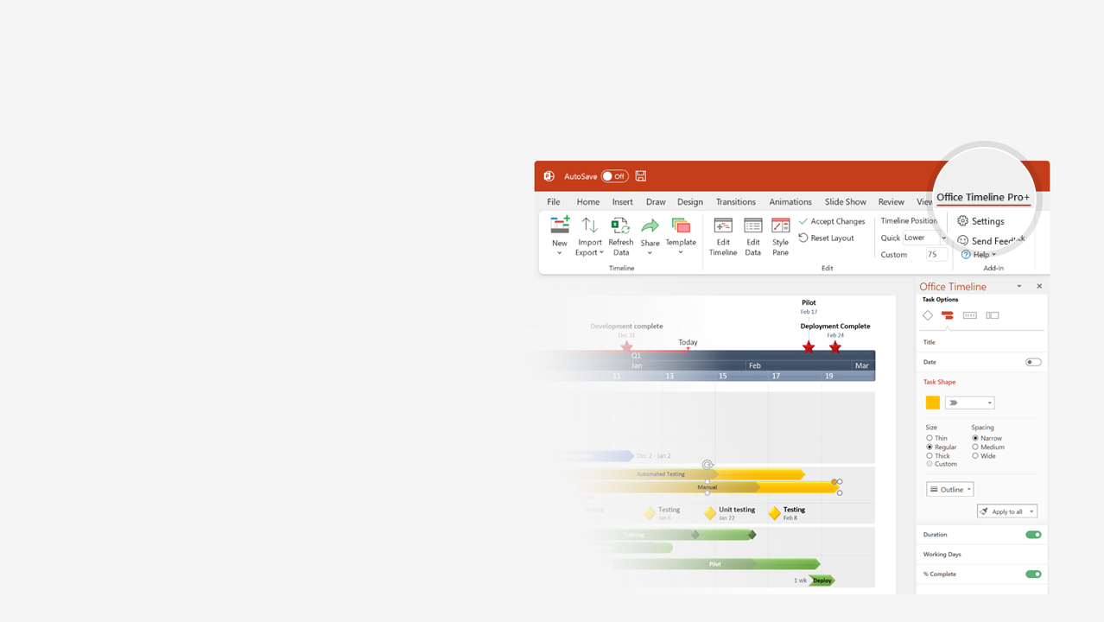

How to update this template in seconds
The Office Timeline add-in for PowerPoint will help you edit it with just a few clicks.
Get your free 14-day trial of Office Timeline here:
https://www.officetimeline.com/office-timeline/14-days-trial
Re-open this template, and create your impressive
PowerPoint visual in 3 easy steps:
1
Click the Edit Data button on the Office Timeline tab.
2
Use the Data and Timeline views to edit swimlanes, milestones and tasks.
3
Click Save to instantly update the template.

Slide 2
PowerPoint Timeline
Milestone 1
Milestone 10
May 10
Oct 16
Milestone 3
Milestone 11
Jun 1
Oct 21
Milestone 4
Milestone 6
Milestone 8
Milestone 12
Milestone 14
Jun 20
Jul 25
Sep 10
Nov 7
Dec 15
Milestone 2
Milestone 5
Milestone 7
Milestone 9
Milestone 13
Milestone 15
2021
May 17
Jul 1
Aug 12
Sep 17
Nov 19
Dec 31
2021
May
Jun
Jul
Aug
Sep
Oct
Nov
Dec
Today

