Slide 1
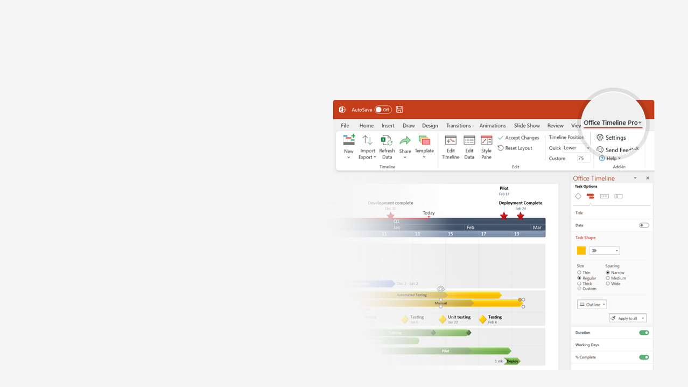

How to update this template in seconds
The Office Timeline add-in for PowerPoint will help you edit it with just a few clicks.
Get your free 14-day trial of Office Timeline here:
https://www.officetimeline.com/office-timeline/14-days-trial
Re-open this template, and create your impressive
PowerPoint visual in 3 easy steps:
1
Click the Edit Data button on the Office Timeline tab.
2
Use the Data and Timeline views to edit swimlanes, milestones and tasks.
3
Click Save to instantly update the template.

Slide 2
Process Map Swimlane Diagram
Pharmaceutical Product Discovery
IND Submission
Jun 2022
Drug Selection
NDA Submission
Approval
Feb 2019
Dec 2027
Jan 2067
2018
2024
2030
2036
2042
2048
2054
2060
2066
Availability
Lifecycle
Discovery
Pre-clinical
Clinical Trials
Licensing Approval
4.5 years
5.5 years
26.5 years
12.5 years
10K Candidates
2018 - 2022
20 Candidates
2022 - 2028
10 Candidates
2028 - 2035
Selection
2-5 Candidates
2035 - 2043
1-2 Drug Candidates
2043 - 2054
1 Drug
2054 - 2067
Reviews
Phase 1 Review
Phase 2 Review
Phase 3 Review
Dec 2034
Jul 2043
Jul 2054

