Slide 1
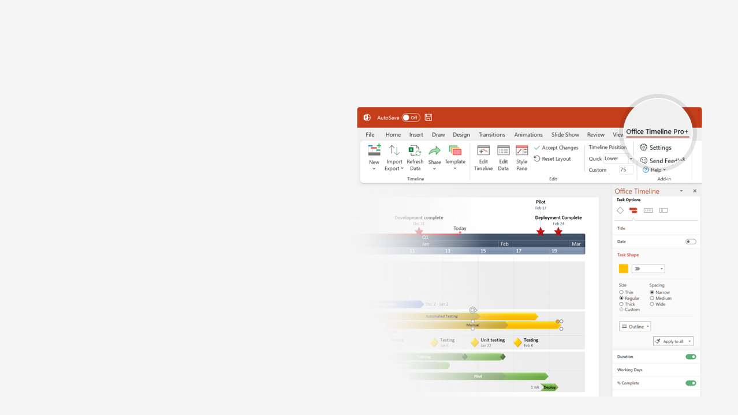

How to update this template in seconds
The Office Timeline add-in for PowerPoint will help you edit it with just a few clicks.
Get your free 14-day trial of Office Timeline here:
https://www.officetimeline.com/office-timeline/14-days-trial
Re-open this template, and create your impressive
PowerPoint visual in 3 easy steps:
1
Click the Edit Data button on the Office Timeline tab.
2
Use the Data and Timeline views to edit swimlanes, milestones and tasks.
3
Click Save to instantly update the template.

Slide 2
Mar 25 - Jun 15
Nov 25 - Feb 13
Oct 11 - Dec 28
Dec 30 - Mar 21
Jan 26 - Mar 21
Mar 19 - Apr 14
Apr 16 - Jun 10
Nov 12 - Dec 31
Jun 2 - Mar 22
Oct 1 - Mar 21
Jan 9 - Mar 24
Jun 15 - Sep 3
Sep 5 - Nov 23
Feb 14 - May 3
May 4 - Jul 22
Jul 24 - Oct 9
Jan 1 - Jan 23
Oct 1 - Jun 1
644.8 days
Oct 1 - Jan 7
53.4 days
58.1 days
57.5 days
57.4 days
56.7 days
57.4 days
18.9 days
35.2 days
58 days
56 days
56 days
71 days
55 days
17 days
40 days
40 days
35 wks
94 wks
20 wks
34 wks
34 wks
36 wks
May 21
Mar 2
2019
Today
SaaS Product Development Plan
Architect: Alex
Dev Lead: Tudor
Dev Lead: Bogdan
Design: Narcis
PM: Carmen
Core Dev
Main Dev
Design
Roadmap with key Milestones and Sprint Schedule
Wave 1: Gemstone
Nov 16 - Apr 5
100%
Wave 2: Pebble
Apr 7 - Dec 1
100%
Wave 3: Sand
Nov 24 - Jul 20
50%
Wave 4: Charting
Jul 19 - Mar 28
0%
Data Grid
Oct 15, 2020
Gemstone
Pebbles
Sand
Product RTW
Mar 29, 2020
Nov 19, 2020
Jul 16, 2021
Mar 2, 2022
Oct
2020
Apr
Jul
Oct
2021
Apr
Jul
Oct
2022
2022
Main Dev
Focus on Charting Dev
MAIN DEV
Hotfix & Feedback
MSP Release
SS Release
Release 3
R4
R5
R6
R7
R8
R9
R10
R11
Design
Customer Feedback
Customer Feedback
Wireframes
Datagrid Mockups
Wireframes
Charting Mockups
Onboarding

