Slide 1
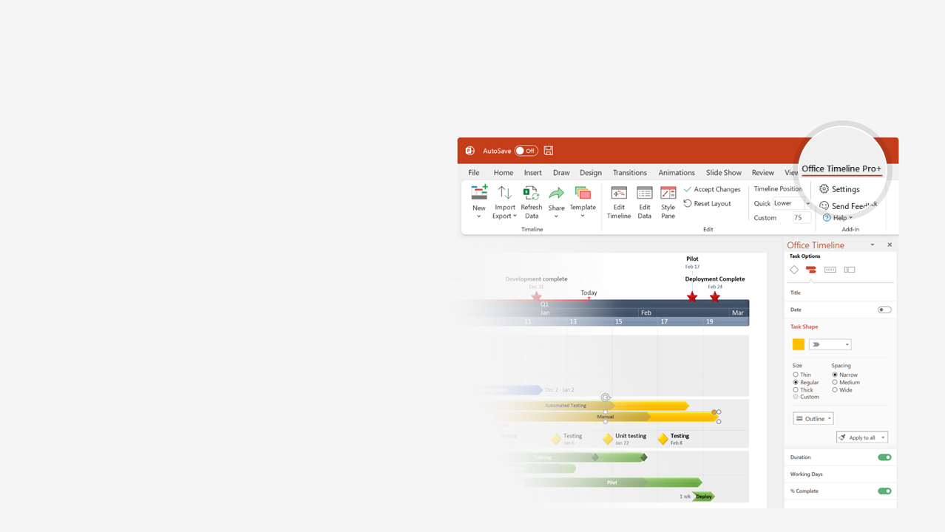

How to update this template in seconds
The Office Timeline add-in for PowerPoint will help you edit it with just a few clicks.
Get your free 14-day trial of Office Timeline here: https://www.officetimeline.com/office-timeline/14-days-trial Re-open this template, and create your impressive PowerPoint visual in 3 easy steps:
1
Click the Edit Data button on the Office Timeline tab.
2
Use the Data and Timeline views to edit swimlanes, milestones and tasks.
3
Click Save to instantly update the template.

Slide 2
Planning R2 Begin
Planning R2 Begin
Planning R2 Begin
May 11 - Jun 30
Jun 30 - Aug 17
Aug 21 - Oct 21
Jan 1 - Feb 24
Mar 1 - May 16
Aug 18 - Oct 4
Apr 1 - May 13
Apr 1 - Oct 21
Nov 1 - Dec 22
Feb 1 - Mar 7
Mar 1 - Apr 1
145.5 days
5/17 - 7/20
25.5 days
54.5 days
34.5 days
30.5 days
21.5 days
43.5 days
40 days
35 days
35 days
36 days
46 days
Mar 14
May 14
Jun 26
Aug 20
Oct 19
Aug 24
May 29
Jun 19
Jul 10
Aug 1
Oct 2
2024
2024
Today
Product roadmap template
Executive Review
Release Candidate
Mar 10
Oct 1
Project Kickoff
Executive Decision
Beta Release
Final Release
Jan 25
Mar 21
Jun 30
Oct 20
2024
Jan
Feb
Mar
Apr
May
Jun
Jul
Aug
Sep
Oct
Nov
Dec
Assemble Resources
Working Plans
Plan
Subcontractor Selection
Helpdesk Content Plan
Planning R2 Begin
Performance Validation
Test Complete
Monitoring
Phase Sync
Load Balance
Test
Integration I
Integration II
Integration III
Prototype
Alpha Build
Development Phase I
Develop
Development Phase II
RC Pilot Deployment
RTW Deployment
V2 Development Begins
Fri, Nov 1, 2024
WW Launch Event
Launch
Beta Blog Launch
July 4, 2024
Gartner Analyst Review
November 1, 2024
Press Release
August 2, 2024
Public Website Live
November 1, 2024

