Slide 1
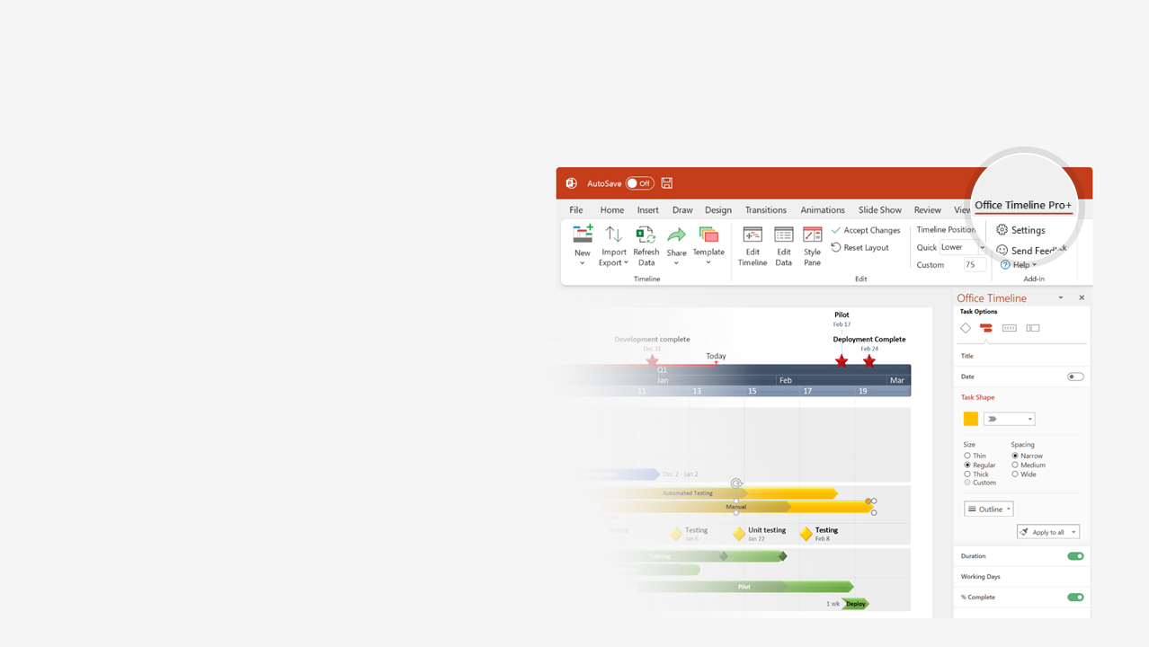

How to update this template in seconds
The Office Timeline add-in for PowerPoint will help you edit it with just a few clicks.
Get your free 14-day trial of Office Timeline here:
https://www.officetimeline.com/office-timeline/14-days-trial
Re-open this template, and create your impressive
PowerPoint visual in 3 easy steps:
1
Click the Edit Data button on the Office Timeline tab.
2
Use the Data and Timeline views to edit swimlanes, milestones and tasks.
3
Click Save to instantly update the template.

Slide 2
0%
0.2 months
Requirements Gathering
Apr 27 - May 2
0%
1 month
Business Requirements Alignment
May 1 - Jun 1
0%
0.4 months
Analysis
May 2 - May 14
0%
1.5 months
Alignment with Other Departments
May 7 - Jun 22
0%
0.8 months
Design Comparisons
May 15 - Jun 8
0%
3 months
Vendor Selection
Jun 1 - Sep 1
0%
19.2 months
Maintenance
Jun 6 - Jan 10
0%
1 month
Effort Estimation
Aug 1 - Sep 1
0%
13 months
PM Preparation
Sep 1 - Oct 1
0%
1.4 months
Prototyping
Oct 17 - Nov 29
0%
8 months
Implementation
Oct 1 - May 30
0%
1 month
API Dev
Nov 11 - Dec 9
0%
6 months
Customization
Jan 1 - Jun 30
0%
1.2 months
User Interface
Jan 2 - Feb 7
0%
1.1 months
Usability
Feb 11 - Mar 14
0%
0.5 months
Testing Matrix
Mar 5 - Mar 19
0%
4 months
Testing 1
May 30 - Sep 30
0%
1.5 months
Testing 2
Sep 1 - Oct 15
0%
2.2 months
Documentation
Sep 20 - Nov 25
0%
2.1 months
Production
Oct 30 - Dec 31
Project Start
5/1/2019
Implementation Finished
Testing Finished
Phase 1 Close
Phase 1 Kickoff
Project Approved
1/1/2021
4/10/2019
7/31/2019
6/16/2020
10/15/2020
2019
Apr
Jun
Aug
Oct
Dec
Feb
Apr
Jun
Aug
Oct
Dec
2021
Today

