Slide 1
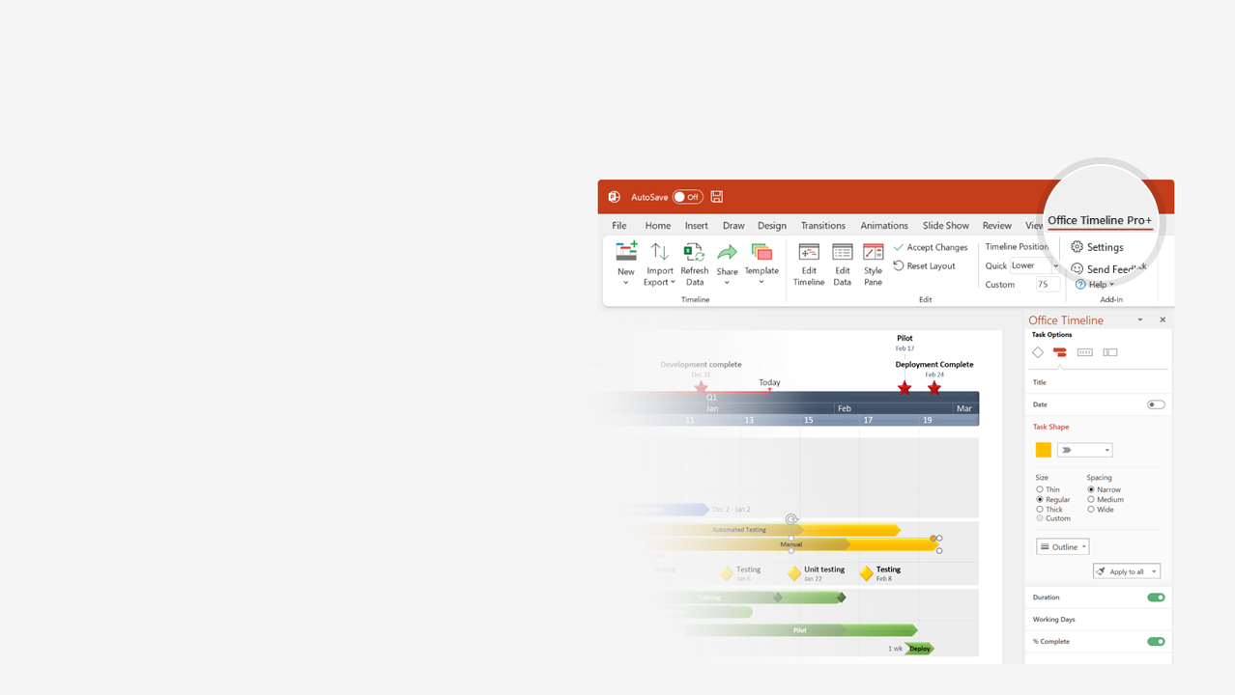

How to update this template in seconds
The Office Timeline add-in for PowerPoint will help you edit it with just a few clicks.
Get your free 14-day trial of Office Timeline here:
https://www.officetimeline.com/14-days-trial
Re-open this template, and create your impressive
PowerPoint visual in 3 easy steps:
1
Click the Edit Data button on the Office Timeline tab.
2
Use the Data and Timeline views to edit swimlanes, milestones and tasks.
3
Click Save to instantly update the template.

Slide 2
16.5 days
5.5 days
14.5 days
11.5 days
11.5 days
4.5 days
4.5 days
11 days
11.5 days
14.5 days
15 days
22.5 days
100%
Jul 29
28%
2023
2023
28/05
Jul 2
Budget Template
Project summary | Actual Budget
Total Budget | $238,306
Actual Budget | $874,967
Jul 10
Jul 15
Jun 14
Budget
Review P1
Budget
Review P3
Budget
Evaluation
Budget
Review P2
Budget
Review P4
Jun
Jul
04/06
11/06
18/06
25/06
02/07
09/07
16/07
23/07
Day 1
6
11
16
21
26
Today
31
36
41
46
51
56
Actual Budget
$5,935
$58,515
$1,847
$808,670
Jun 5 - Jun 9
Jun 10 - Jun 16
Task 1
Task 2
Project 1
100%
100%
Jun 8 - Jul 10
Jun 5 - Jun 25
Task 3
80%
Task 1
Jul 2 - Jul 10
Project 2
Task 2
Jul 2 - Jul 25
Task 3
Project 3
Jun 2 - Jun 19
Jun 22 - Jul 7
Jul 10 - Jul 29
Task 1
Task 2
Task 3
Project 4
Jun 2 - Jun 19
Jun 22 - Jul 7
Jul 10 - Jul 29
Task 1
Task 2
Task 3

