Slide 1
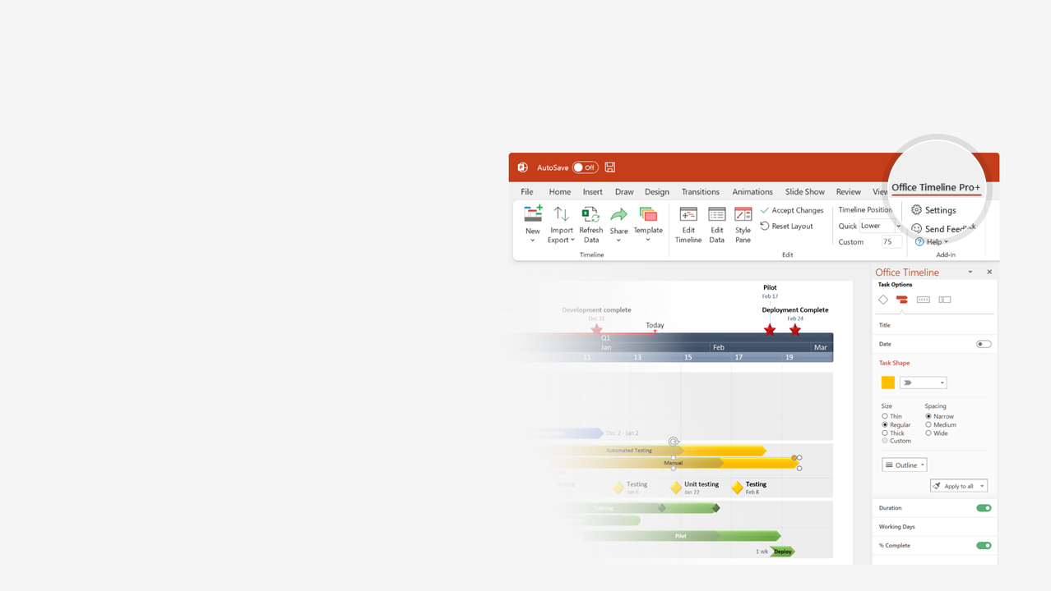

How to update this template in seconds
The Office Timeline add-in for PowerPoint will help you edit it with just a few clicks.
Get your free 14-day trial of Office Timeline here:
https://www.officetimeline.com/office-timeline/14-days-trial
Re-open this template, and create your impressive
PowerPoint visual in 3 easy steps:
1
Click the Edit Data button on the Office Timeline tab.
2
Use the Data and Timeline views to edit swimlanes, milestones and tasks.
3
Click Save to instantly update the template.

Slide 2
10 days
100%
SECTION 1
May 19 - Jun 2
4 days
3 days
3 days
Sub-task
Sub-task 2
Sub-task 3
5/19 - 5/23
5/24 - 5/28
5/29 - 6/2
11 days
SECTION 2
Jun 3 - Jun 17
65%
2 days
3 days
5 days
1 day
Sub-task 1
Sub-task 2
Sub-task 3
Sub-task 4 - zero duration
6/3 - 6/4
6/5 - 6/9
6/10 - 6/16
6/17
12 days
SECTION 3
Jun 18 - Jul 3
15%
4 days
5 days
3 days
Sub-task 1
Sub-task 2
Sub-sections 1
6/18 - 6/23
6/24 - 6/29
6/30 - 7/3
4 days
Sub-sub-task 1
6/27 - 7/2
1 day
Sub-sub-task 2
7/3
2019
2019
Week 1
2
3
4
5
6
7
2019
Today
Thu May 23
Tue Jun 18
Milestone 2
Mon Jun 3
Milestone 4
Wed Jul 3
Sun May 19
Milestone 3
Milestone 5
Milestone 1

