Slide 1
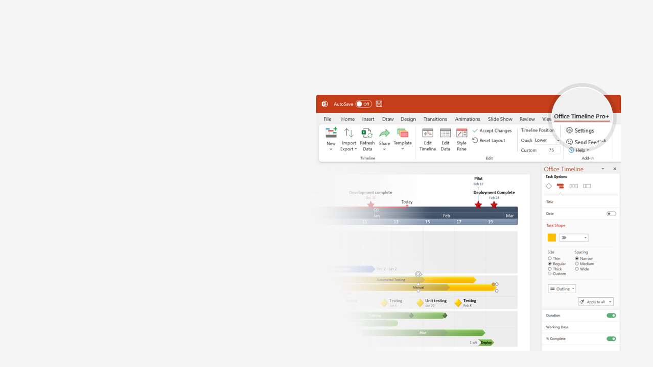

How to update this template in seconds
The Office Timeline add-in for PowerPoint will help you edit it with just a few clicks.
Get your free 14-day trial of Office Timeline here:
https://www.officetimeline.com/office-timeline/14-days-trial
Re-open this template, and create your impressive
PowerPoint visual in 3 easy steps:
1
Click the Edit Data button on the Office Timeline tab.
2
Use the Data and Timeline views to edit swimlanes, milestones and tasks.
3
Click Save to instantly update the template.

Slide 2
0%
3 days
Create project charter
May 30 - Jun 3
0%
7 days
Process definition
May 31 - Jun 10
0%
5 days
Define deliverables
Jun 1 - Jun 7
0%
8 days
Monitoring Phase
Jun 5 - Jun 15
0%
9 days
Validate data collection
Jun 1 - Jun 13
0%
7 days
Analysis
Jun 13 - Jun 22
0%
3 days
Program capability
Jun 14 - Jun 18
0%
4 days
Performance levels
Jun 15 - Jun 20
0%
7 days
Review work breakdown
Jun 19 - Jun 27
0%
5 days
Adjustments Phase
Jun 15 - Jun 22
0%
3 days
Triage causes
Jun 22 - Jun 26
0%
3 days
Monitoring
Jun 26 - Jun 30
Metrics 1
Metrics 2
Operating snapshot
Metrics 3
Jun 12
Jun 20
Jun 26
Jul 2
2019
Day 1
6
11
16
21
26
31
2019
Today
May 29
Jun 7
Jun 16
Jun 22
Jun 28
Identify client issues
Performance thresholds
Statistical review
Adjustments Complete
Implementation

