Slide 1
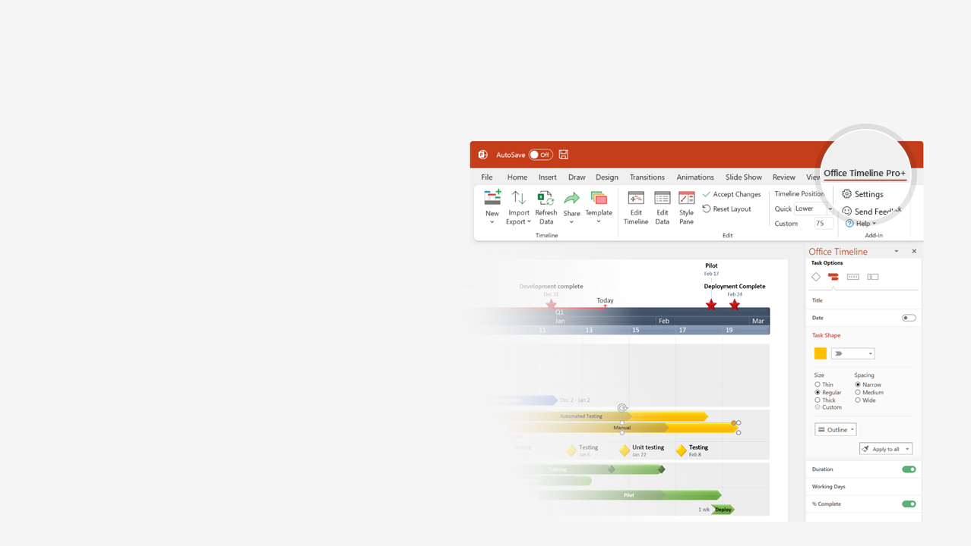

How to update this template in seconds
The Office Timeline add-in for PowerPoint will help you edit it with just a few clicks.
Get your free 14-day trial of Office Timeline here: https://www.officetimeline.com/14-days-trial Re-open this template, and create your impressive PowerPoint visual in 3 easy steps:
1
Click the Edit Data button on the Office Timeline tab.
2
Use the Data and Timeline views to edit swimlanes, milestones and tasks.
3
Click Save to instantly update the template.

Slide 2
Project Plan
PROJECT OWNER:
[Enter Name]
Q3
Q4
Aug
Sep
Oct
24
28
01
05
09
13
17
21
25
29
03
Kick Off
Milestone team 1
Milestone team 2
Milestone team 3
Sign Off
Milestones
Aug 24
Sep 3
Sep 20
Oct 2
Oct 6
Task 1
Task 2
Team 1
Aug 24 - Sep 1
Sep 4 - Sep 12
 | Planned
 | Actual
Aug 24 - Sep 1
Sep 5 - Sep 18
Task 1
Task 2
Task 3
Task 4
Aug 24 - Aug 29
Sep 5 - Sep 22
Aug 27 - Aug 31
Sep 6 - Oct 1
Team 2
Task 3
Task 4
Task 5
Sep 28 - Oct 5
 | Planned
 | Actual
Sep 29 - Oct 6
Task 5
Task 6
Task 8
Aug 27 - Sep 5
Sep 17 - Sep 26
Aug 28 - Sep 7
Sep 19 - Sep 30
Team 3
Task 6
Task 8
Task 7
Task 9
Sep 2 - Sep 12
Sep 22 - Sep 29
 | Planned
 | Actual
Sep 3 - Sep 13
Sep 21 - Oct 3
Task 7
Task 9

